Slide 1
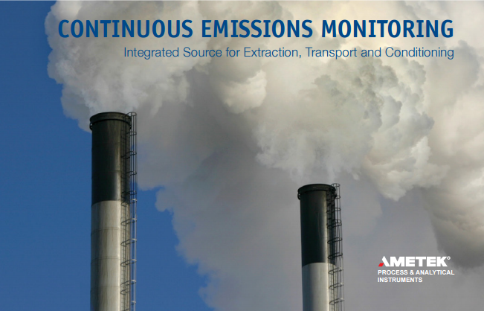
CEMS Umbilical Overview
Presented by:
Scott Ruben
Senior Project Engineer
O’Brien Ametek

Slide 2

CEMS Umbilical Overview
Topics
Company background
Purpose
Types of Umbilicals
Design Process
Configurations
Arrival Inspections
Preinstall / Storage instructions
Install Instructions
Best Practices
Finishing and Power up
Permeation, Burn-in, and Flushing
Maintenance
Questions

Slide 3
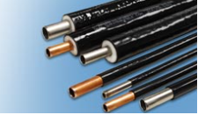

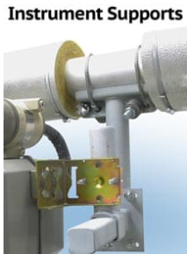
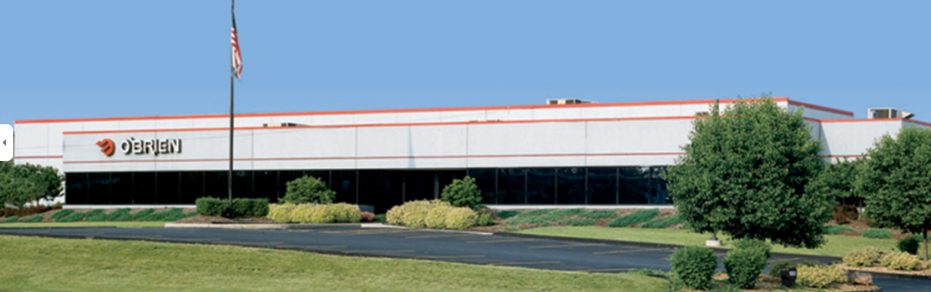
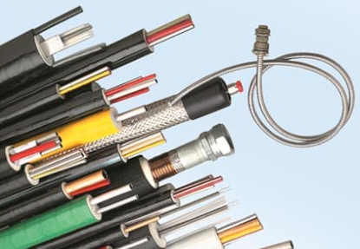
CEMS Umbilical Overview
Company overview
For over 50 years, O'Brien has been supplying the petrochemical, refining, pulp & paper, and power industries with quality products based on the application of our heat transfer expertise. Our recommendations and products reflect our knowledge of industry practices, regulations, and code requirements so you are assured of a complete solution for your specific application.
Product offering
Tubing Bundle
TracePak and StackPak
Jacketed tubing
Insulated tubing
Enclosures
ViPak, FlexPak, HeatPak, and Sunshades
Instrument stands
SaddlePak

Slide 4
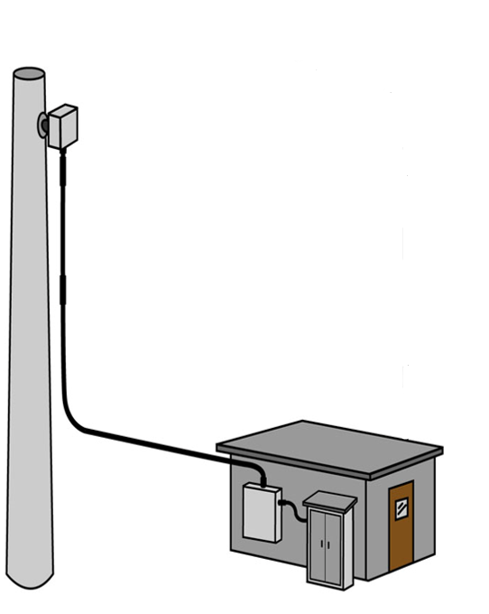
CEMS Umbilical Overview
Purpose
Purpose:
Eliminate specification problems between components
Single source responsibility for design, installation details and operation
Properly sized and configured sample probe and sample transfer line
Maintain consistent temperature profile in the heated sample line
Reduce sample dew point with minimum loss to water soluble compounds
Provide a properly conditioned sample at a stable dew point delivered to your analyzer from one source.

Slide 5

CEMS Umbilical Overview
Types of umbilicals
Below are the basic types with some typical configurations:
Straight Extractive
Natural gas (simple or combined cycle)
250F or greater maintain temperature
1 heated tube / 2 unheated tubes (blowback/cal)
Messenger wires (heater/relays/solenoid valves/thermocouples)
Dilution
Coal fired
Freeze protection only
1 heated tube / 5 unheated tubes (blowback/cal/vacuum/air/fast loop)
Messenger wires (heater/relays/solenoid valves/thermocouples)
Mercury CEMS
Coal fired
Originally 320F, then 250F, now as low as 120F maintain
2-3 heated tubes / 3+ unheated tubes (blowback/cal/vacuum/etc)
Messenger wires (heater/relays/solenoid valves/thermocouples)

Slide 6
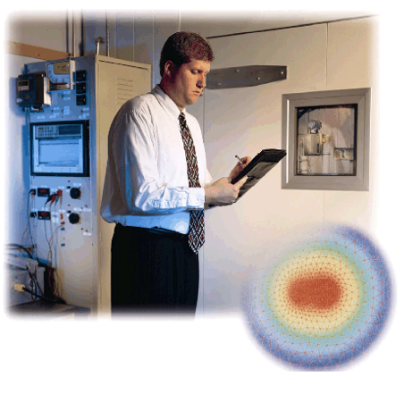
CEMS Umbilical Overview
Design Process
O’Brien TracePak/StackPak design starts with input from the Customer:
Ambient temperatures (high/low)
Maintain temperature
Maximum inlet temperature
Operating voltage and circuit breaker sizing
Heated process tubes (qty, size, metallugy, approval specs)
Unheated calibration/misc tubes (qty, size, metallurgy, specs)
Area approval requirements (Div 2, Zone 1, general, etc)
Temperature control/monitoring equipment and method
Run length(s)
End preparation
Jacket material and color
Special printing on outer jacket

Slide 7
CEMS Umbilical Overview
Design Process
Tube size(s) and metallurgy is ultimately up to the customer to determine
Standard CEMS offerings:
PFA Teflon
316/316L Stainless Steel
  Other tubing available:
Alloy 625
Alloy 825
Alloy 400
Alloy C22/C276
Copper
Duplex/Super Duplex 2205/2507
Processes available on 316/316L:
Chemical Passivation
Passivation/SilcoNert
ElectroPolishing
EP/SilcoNert

Slide 8
CEMS Umbilical Overview
Design Process
O’Brien recommendations
Don’t overinflate your maintain temperature requirement.
Higher maintains
Draw more current/power consumption
Require larger breakers
Shorter circuit lengths
Use more expensive tracers
Shorter life of tracer
If using Teflon tubing for heated/process tubes:
Use the heaviest wall possible
Use the lowest maintain possible
All Teflon is porous, higher temperatures make the tubing more porous.
This may lead to more permeation/off-gassing issues

Slide 9
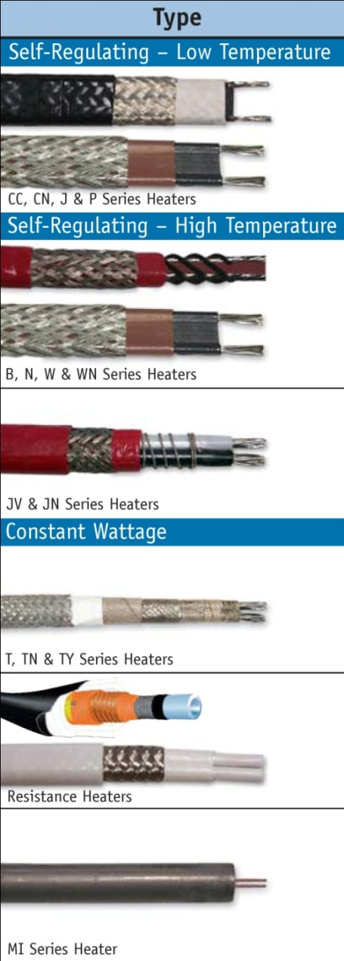
CEMS Umbilical Overview
Design Process
Electric Heat Trace
Tracer selection is based on the following criteria:
Maintain temperature
Exposure temperature
Operating voltage
Circuit length
Cut-to-length requirements
Electrical approvals
Common types of electric tracers:
Self-Regulating
Power-limiting
Constant Power Density
Series Resistance (M.I.)

Slide 10
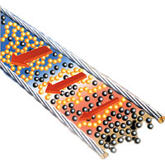
CEMS Umbilical Overview
Design Process
Self-Regulating Tracer
Power output changes at the tracer heats up
Pros
Maintain temperatures up to 250F/121C
Cut to length
Some designs do not require temperature control
Class 1, Div 2 approved (Div 1 option)
Robust construction
Cons
Inrush current on startup
At higher maintains, output may not be enough
O’Brien examples:
Raychem BTV and XTV

Slide 11
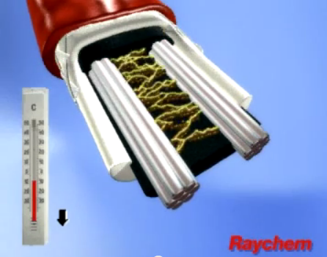
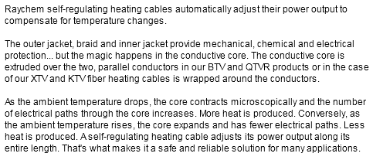
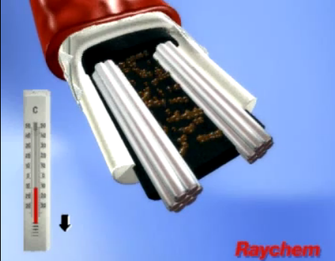
CEMS Umbilical Overview
Design Process
How does self-regulating heat trace work?

Slide 12
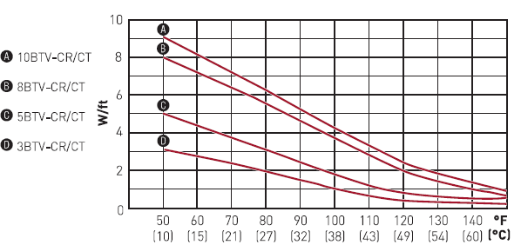
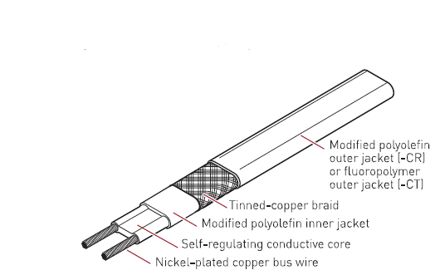

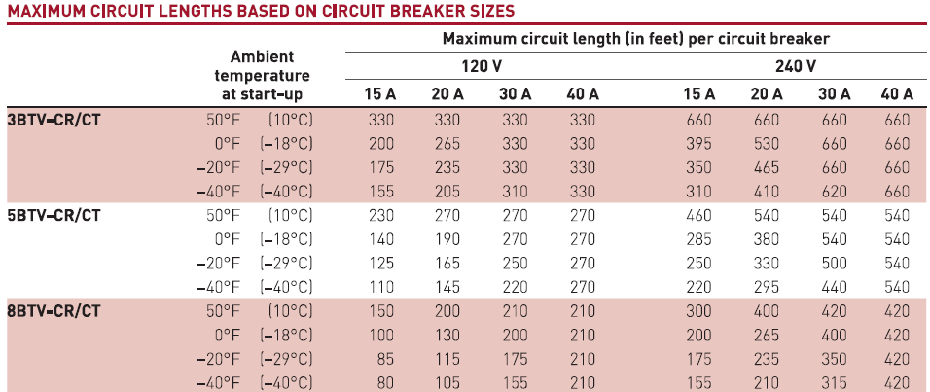
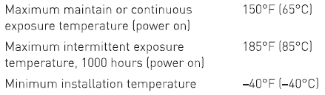
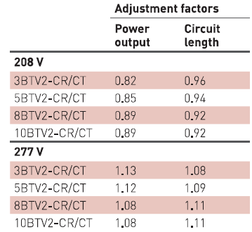
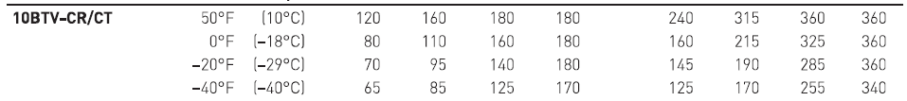
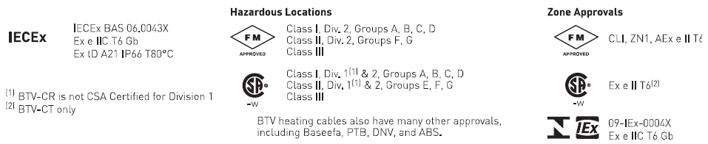
CEMS Umbilical Overview
Design Process

Slide 13
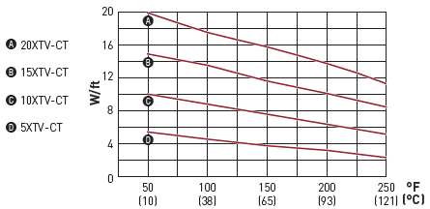
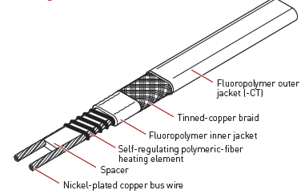


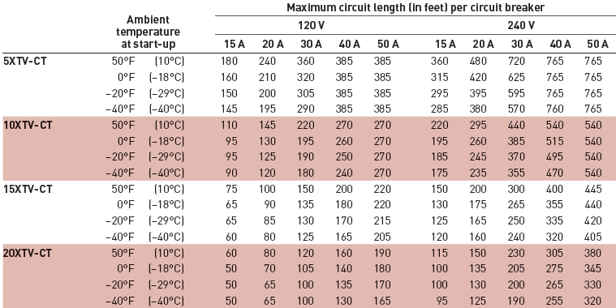
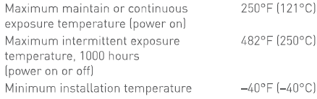
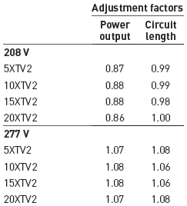
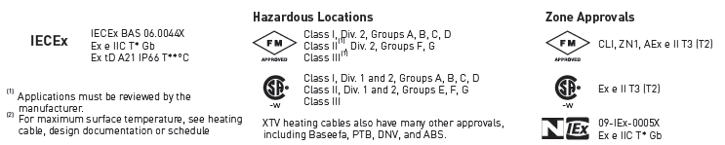
CEMS Umbilical Overview
Design Process

Slide 14
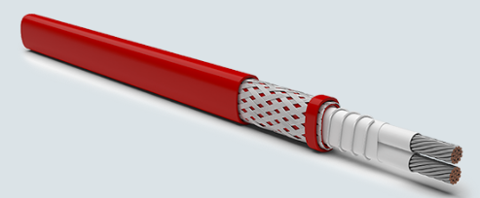
CEMS Umbilical Overview
Design Process
Power-Limiting Tracer
Power output changes at the tracer heats up
Pros
Maintain temperatures up to 455F/230C
Cut to length but zones must be respected
Class 1 Div 2 approved
Cons
Zones can be damaged
Inrush current on startup but less than BTV and XTV
At higher maintains, output may not be enough
Expensive
O’Brien examples:
Raychem VPL

Slide 15
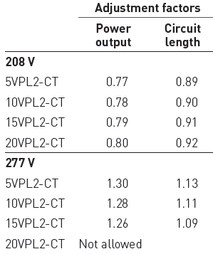
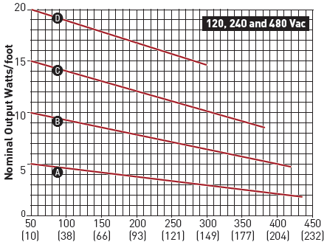
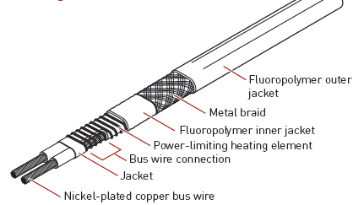

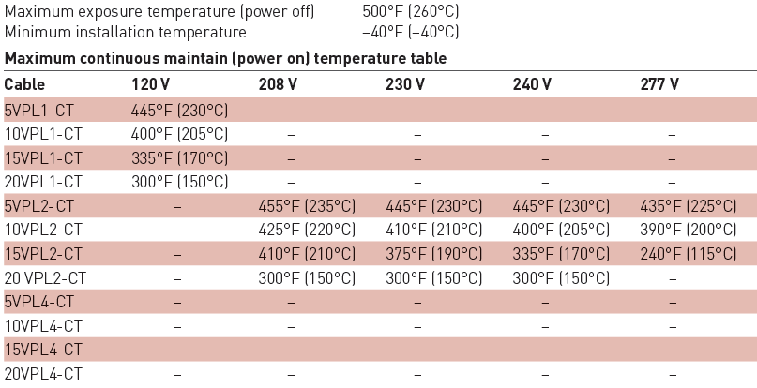
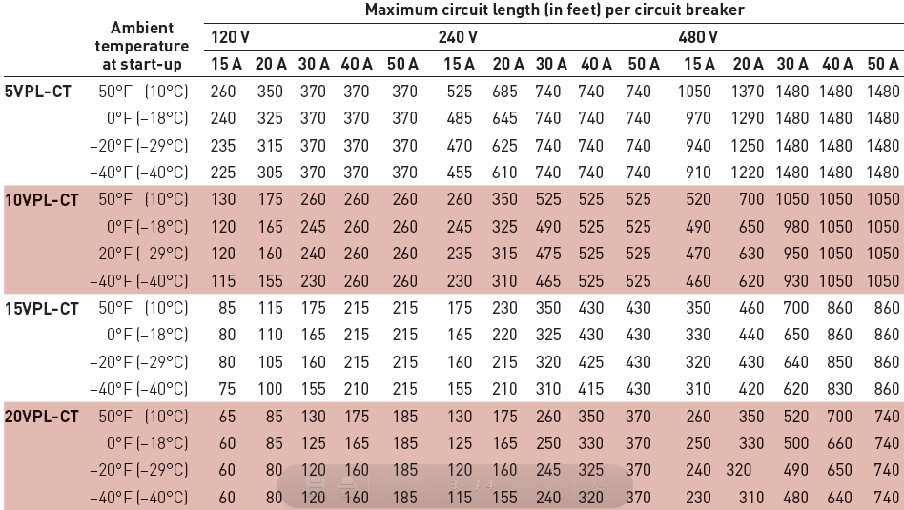
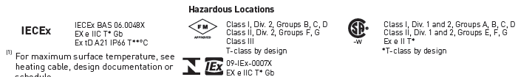
CEMS Umbilical Overview
Design Process

Slide 16


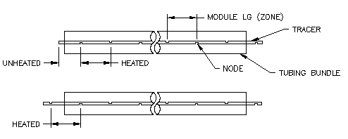
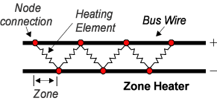
CEMS Umbilical Overview
Design Process
VPL zone diagram

Slide 17
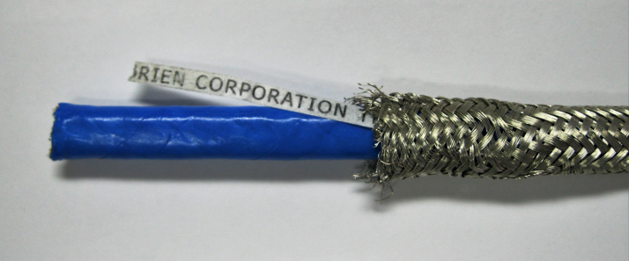
CEMS Umbilical Overview
Design Process
Constant Power Density (CPD) Tracer
Specific output tracer under all conditions
Pros
Maintain temperatures up to 400F/204C
Cut to length but zones must be respected
Continuous output allows for high maintain temperatures
Cons
Zones can be damaged
More care must be taken during installation
Cannot be used in Class 1 Div 2 areas
General Purpose area
O’Brien examples:
O’Brien T-series (T18, TY18, TN18)

Slide 18
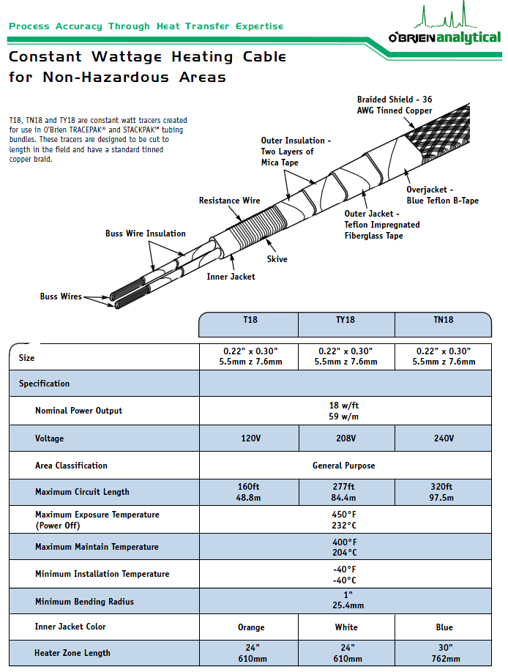
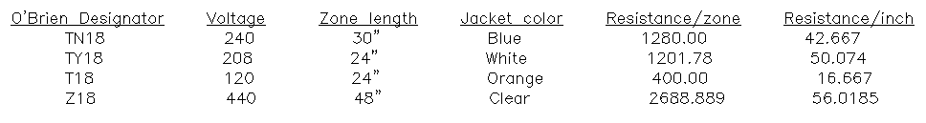
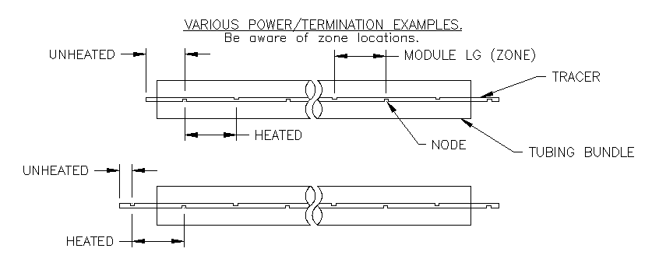
CEMS Umbilical Overview
Design Process

Slide 19
CEMS Umbilical Overview
Design Process
Series Resistance Tracer
Specific resistance under all conditions
Pros
Maintain temperatures up to 1022F/550C
Pre-terminated ends
Class 1, Div 1 approved
Cons
Output based on resistance wire
Cannot be cut to length, order specific length
Long lead times
Expensive
O’Brien examples:
Raychem/Pyrotenax MI-Alloy 825

Slide 20

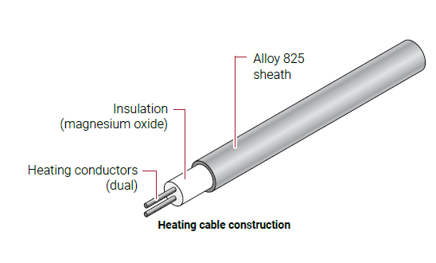
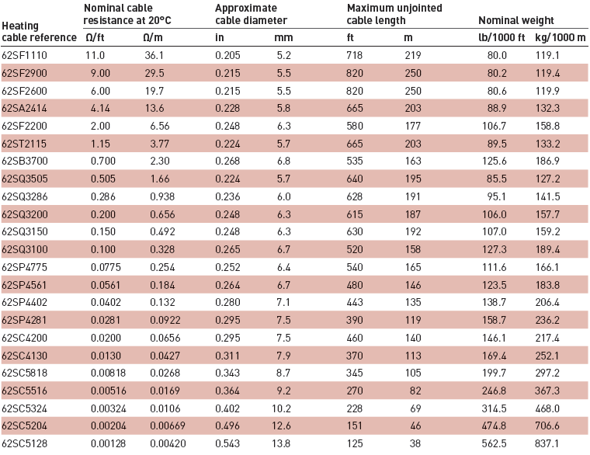

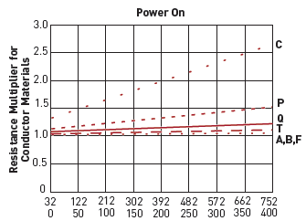
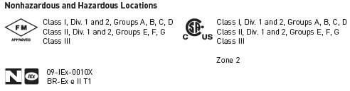
CEMS Umbilical Overview
Design Process

Slide 21
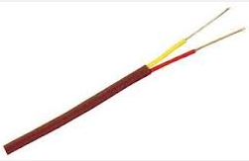
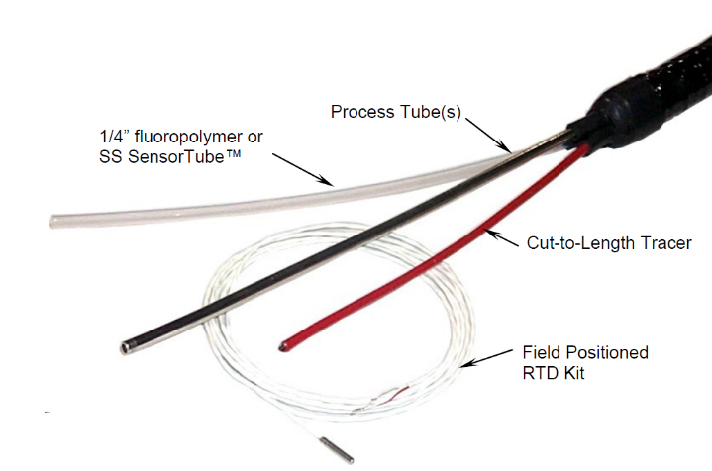

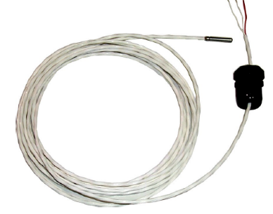
CEMS Umbilical Overview
Design Process
SensorTube
1/4” and 3/8”
Temperature Sensors
Type J/K thermocouples
Factory install
Field install
SensorTube
RTD 3-wire PT100
Factory install
Field install
SensorTube

Slide 22
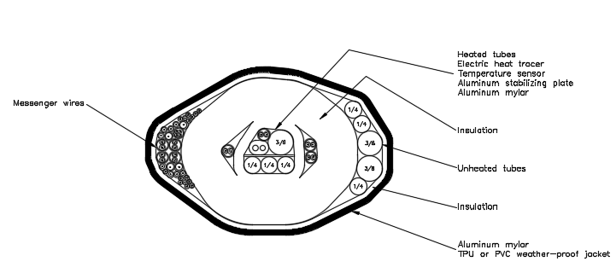
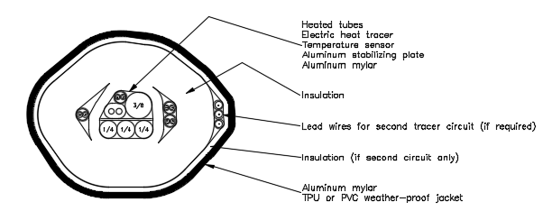
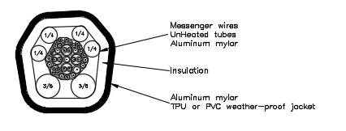
CEMS Umbilical Overview
Configurations
All-in-One
Two bundle
Heated
Unheated

Slide 23
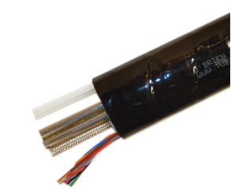
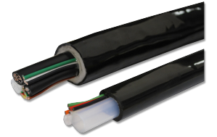
CEMS Umbilical Overview
Configurations
All-in-One approach
Heated and unheated material in the same tubing bundle
Pros:
One bundle to install
Lower initial cost
Cons:
Larger, heavier bundle can be more difficult to install
If tracer fails, entire bundle must be replaced
Two bundle approach
One bundle has all heated tubes, second bundle has unheated
Pros:
If tracer fails, only replacing the heated line
Two smaller bundles to install, instead of one larger
Cons:
More expensive to purchase
More expensive to install
In some applications, only a two bundle is available

Slide 24






CEMS Umbilical Overview
Configurations
End Preparation Options

Slide 25


CEMS Umbilical Overview
Configurations
Jacket Materials

Slide 26

CEMS Umbilical Overview
Arrival Inspections
Visual check (umbilical and spool) for damage/cuts/rips
Resistance check of tracer
Megger test tracer
Continuity check of all messenger wires
Temperature sensor(s) reading
Print on jacket verification against PO/SO
Confirm correct product and quantity
Umbilical ends must be protected from moisture ingress at all times
Moisture is the enemy of the thermal insulation
If you have any questions, please contact O’Brien Engineering

Slide 27
CEMS Umbilical Overview
Arrival Inspections
Resistance check
Buss-buss wire resistance measurement
Self reg/Pwr limiting tracer
Both tracer ends within 0.2 ohm of each other
CPD tracer
Using Ohm’s Law, resistance +/-10% of nominal
Megger test
1000vdc
Buss wires to tracer ground braid
20mOhm or greater resistance
Record values for future comparison

Slide 28
CEMS Umbilical Overview
PreInstall / Storage Instructions
Store indoors if possible
Store off of the ground
Keep ends weather sealed
Keep away from traffic to reduce chance of damage
Umbilical ends must be protected from moisture ingress at all times
Moisture is the enemy of the thermal insulation

Slide 29
CEMS Umbilical Overview
Installation Instructions
Plan the installation with the appropriate number of qualified personnel
Use Kellum style grips to pull vertical sections
Post personnel at all bends/turns to avoid damage
Do not twist the sample line
Use wide bands or clamps to hold in final position
Horizontal runs require a maximum of 6ft spacing between supports
Vertical runs require a maximum of 15ft spacing between supports
Use a downward slope from the probe to the analyzer
Supports need to be rigidly held
Do not over-clamp or deform the sample line
Fully support all bends
Do not exceed the minimum bend radius (8” or 12” depending on design)
Avoid running near external heat sources
Keep a minimum of ½” air gap between lines
Do not run in an enclosed tray, air must be allowed to circulate
Once installed and clamped, complete a visual inspection to look for
damaged jacket, unsupported areas, or tight bends
Protect from moisture ingress/seal ends

Slide 30


CEMS Umbilical Overview
Installation Instructions
Can provide spool with probe end or power end off first. (Probe end first is standard)

Slide 31





CEMS Umbilical Overview
Installation Instructions
Recommended primary support method
½“ minimum width cable ties
Outdoor rated
Black acetal or UV resistant black nylon
Kellems Grip for pulling into place all vertical runs
50ft maximum spacing
Once installed may be used as secondary support
Recommended primary support method
Strut clamps with plastic insert
Galvanized or stainless steel
Support requirements
15ft minimum spacing on vertical runs
6ft minimum spacing on horizontal runs
Permanent clamping on rigid support structure/non-moving

Slide 32


CEMS Umbilical Overview
Installation Instructions
Confirm correct ends
Position close to stack base
Use a pipe and stand to allow the spool to be uncoiled
Use Kellum grips to pull vertical sections

Slide 33


CEMS Umbilical Overview
Installation Instructions
Continue pulling up stack until reaching probe. Account for extra for tracer termination, tube connections and wire hookups.

Slide 34


CEMS Umbilical Overview
Installation Instructions
Pull remaining umbilical off of spool. Feed into shelter. Account for extra at shelter end for tracer power connection, tube connections, and wire hookups.

Slide 35


CEMS Umbilical Overview
Installation Instructions
Attach final permanent support
Leave Kellum grips in place and anchor
Make probe connections
Weather seal

Slide 36


CEMS Umbilical Overview
Installation Instructions
Make final routing connections
Make connections at shelter end
Conduct final electrical checks
Weather seal

Slide 37



CEMS Umbilical Overview
Best Practices
Bad : Possible Damage to entire construction: Jacket, Insulation, Heater Cable
Good: Use Kellums grip or Closed Mesh Support Grip, proper rigging, and supports to protect bundle/umbilical

Slide 38



CEMS Umbilical Overview
Best Practices
X
X
√
X
√

Slide 39


CEMS Umbilical Overview
Best Practices
√
X

Slide 40

CEMS Umbilical Overview
Best Practices

Slide 41

CEMS Umbilical Overview
Best Practices

Slide 42

CEMS Umbilical Overview
Best Practices
Troubleshooting
While the most common cause of trouble/failure is water/moisture related, below is a list of basic troubleshooting checks to make in no particular order.
1) Moisture/water ingress
Conduct a visual inspection along the length of the tubing bundle looking for cuts//tears/deformations in the outer jacket. Also look for repairs or field installed temperature sensors. Look at the ends and confirm they are weather sealed. The tubing bundle should feel firm to the touch.
2) Confirm model of tubing bundle. Check original design.
3) Confirm both correct voltage and circuit breaker sizing including checking the proper function.
4) Confirm circuit length doesn’t exceed limits.
5) Confirm maintain temperature doesn’t exceed limits or design.
6) Confirm proper operation of temperature controller.
7) Check resistance and conduct Megger test on heat trace.
8) Confirm functioning temperature sensor.
9) Check for proper installation and support. Look for hard bends,
unsupported areas, and near heat sources.
10) Confirm no electrical anomalies or events have occurred (electrical
spikes, severe storms, etc).
11) Check for proper wiring.
12) Check for approved and properly installed tracer kits.
13) Confirm electrical connection of any plugs/receptacles installed.
14) If using GFCI, check for trip level.
15) Conduct flow and pressure test on heated tubes.
16) Confirm one-time installation.
17) Have customer send pictures of installation including overall
layout, power connection and end termination areas.
18) Gather information on what led up to the failure/event.

Slide 43


CEMS Umbilical Overview
Finishing and Power up
Make final checks at each end of the umbilical
Resistance check and Megger test tracer
Make and confirm proper tracer connections
Confirm temp sensor(s) functionality
Confirm tube and wire connections
Confirm weather sealing
Confirm temp controller operation and settings
Follow routing of the entire length, look for
Proper support
No bend radius exceeded
No cuts/tears/rips in outer jacket
Power up umbilical and monitor until reaching setpoint and proper cycling
Investigate any irregularities

Slide 44
CEMS Umbilical Overview
Permeation, Burn-in, and Flushing
As stated earlier, if using Teflon tubing CO migration/permeation may occur. The following steps can reduce or eliminate this issue.
Burn-in
Power umbilical at the highest safe temperature allowed. This should accelerate the CO migration process. Pull sample from fresh air (filtered) instead of the stack if possible. This process may take 1 week or more. Depending on the application, some permeation may continue but the level usually flatlines.
Flushing
There are many tube flushing processes used by customers. The only process that O’Brien promotes is a D.I. water flush followed by a Nitrogen gas drying.

Slide 45
CEMS Umbilical Overview
Permeation, Burn-in, and Flushing
Below is a typical cleaning/flushing procedure. This is not specifically endorsed by O’Brien Ametek.
Disconnect heating power from the umbilical line.
Allow the line to cool to ambient temperature.
Disconnect the Sample and Calibration Gas lines from the probe and analyzer.
Flow cleaning agent down each line, collecting the residue in a container for proper disposal as required by your protocol.
  A. Recommended Order
    Distilled or D.I. water
    Vinegar or 5-10% Nitric Acid solution
    Distilled or D.I. water (if step II is utilized)
    Note: Flow D.I. water (preferred) or distilled water until a complete rinse is achieved. Typically, 2x the rinse agent to the cleaning agent.
Blow dry for a minimum of 30 minutes or until no water droplets are present.

Slide 46

CEMS Umbilical Overview
Permeation, Burn-in, and Flushing
Continued
Reconnect the line to the probe only.
Repower the umbilical line and allow to heat to temperature.
Reconnect sample line to analyzer/shelter end.
Allow system to stabilize.
Calibrate the system and validate the systems stabilization.
Return the system to service.
Note: The system may show some drift for as much as 3 days of operation before returning to total normal operation.

Slide 47

CEMS Umbilical Overview
Maintenance
Suggested maintenance
Weekly
Visual checks
Temperature controller proper operation and alarm status
Monthly
Visual checks
Temperature controller proper operation and alarm status
Routing of umbilical and checks for damage/weather sealing
Annually
Temperature controller proper operation and alarm status
Tracer Megger test
Tracer resistance check
Temperature sensor check

Slide 48

CEMS Umbilical Overview
Questions

