Slide 1
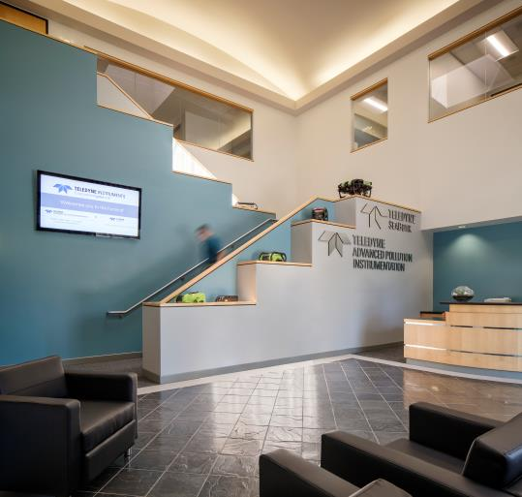
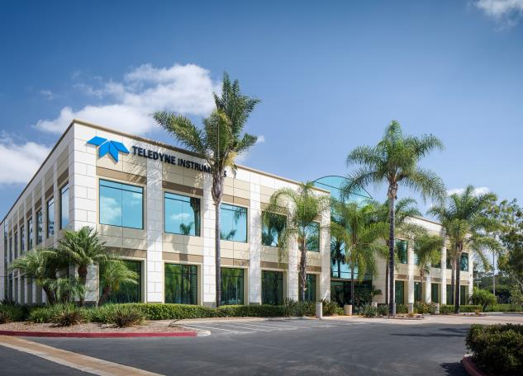
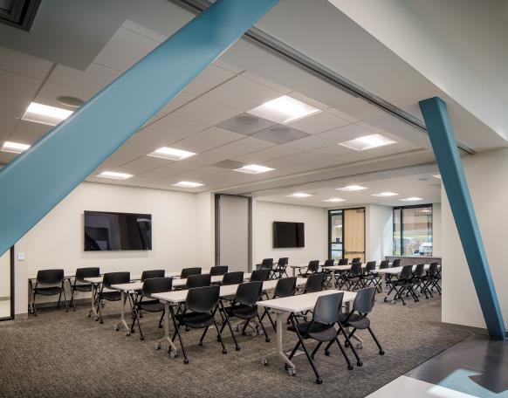
Teledyne API – San Diego Facility

Slide 2

Teledyne-API is a leading supplier of the following instrumentation products and services:
Ambient air quality gas analyzers
Source level emissions gas analyzers
Zero-air Generators
Dynamic Dilution Calibrators
Particulate Monitors
Technical support services
  Service support
  Repair
  Training

Slide 3
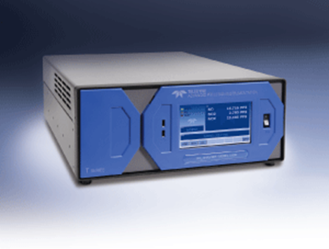
Ambient air quality gas analyzers:
T Series & N Series gas analyzers
Gases measured:
  SO2, H2S, TRS, TS
  NO, NO2, NOx, NOy, NH3, “True NO2”, “Direct NO2”
  CO, CO2
  O2, O3
Measurement technologies:
  UV Fluorescence
  Chemiluminescent w/ Moly or Photolytic Converter; Cavity Attenuated Phase Shift (CAPS)
  IR Gas Filter Correlation
  UV Absorption
  Paramagnetic
Most analyzers available in ambient, source and trace level versions
All ambient analyzer models US EPA FEM or FRM approved
T-API provides many analyzers to federal, state and local regulatory agencies, including: USEPA, CARB, SCAQMD, SDAPCD, etc.
NumaView software

Slide 4
Source level emissions gas analyzers:
T Series and N Series gas analyzers
Gases measured:
  SO2, TRS
  NO, NO2, NOx
  CO, CO2,
  O2
Measurement technologies:
  UV Fluorescence
  Chemiluminescent w/ Moly or SS converter
  Gas Filter Correlation IR
  Paramagnetic
Most analyzers available in mid and high level versions, with dual ranges
T-API provides analyzers to many CEMS integrators for compliance monitoring
NumaView software

Slide 5
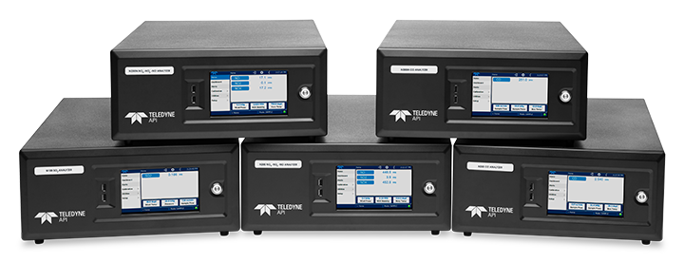
N Series Gas Instruments
September, 2022

Slide 6
N Series Highlights
Smart Internal Hardware Modules
  — Easy field replacement with pre-calibrated and tested modules
CAN Bus Communications Architecture
  — Simplified, common cabling for increased reliability
24VDC Internal Power
  — Lower power consumption and unified power requirement
Split Fold-down Rear Panel
  — Access to internal pneumatic connections
NumaViewTM Software Interface
  — Familiar, mature, and customizable with real-time graphing, diagnostic alerts, and
  preventative maintenance capabilities
Flow System Module with Pump Duty Cycle Control*
  — Reduces pump duty cycle for increased lifetime
* PDCC is on internal pumps only for certain models

Slide 7
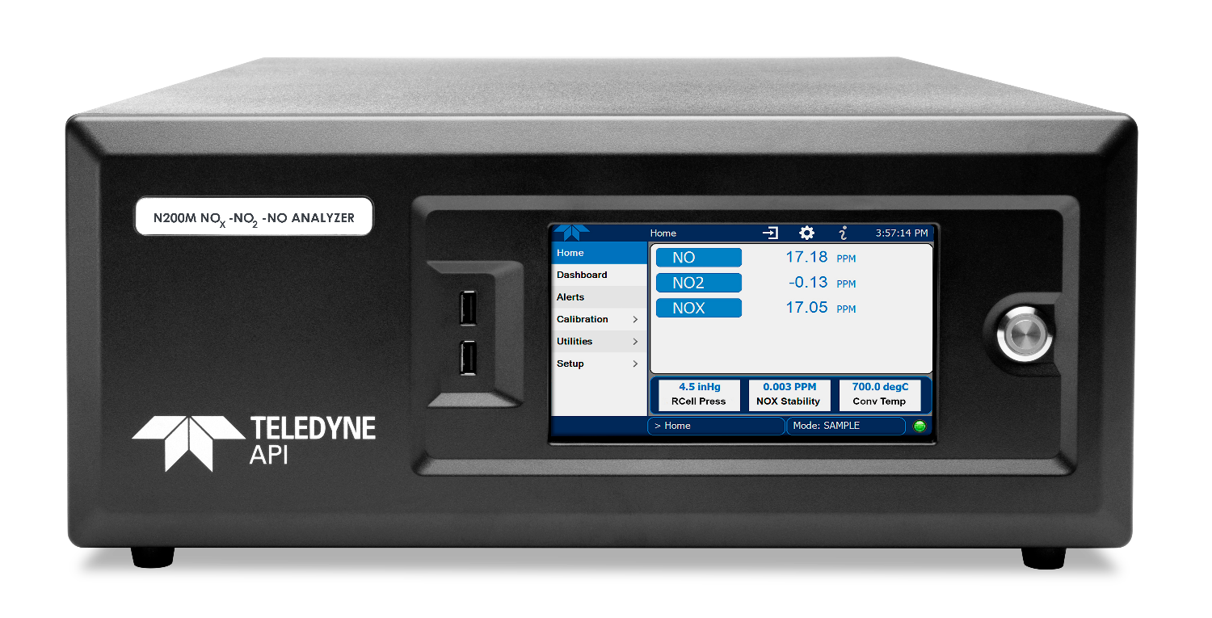
N Series Front Panel
Standard 19” rack mountable chassis
Optional ears, handles, and/or slides
Capacitive, color touch-screen display
2 front-panel USB ports
Soft power switch

Slide 8
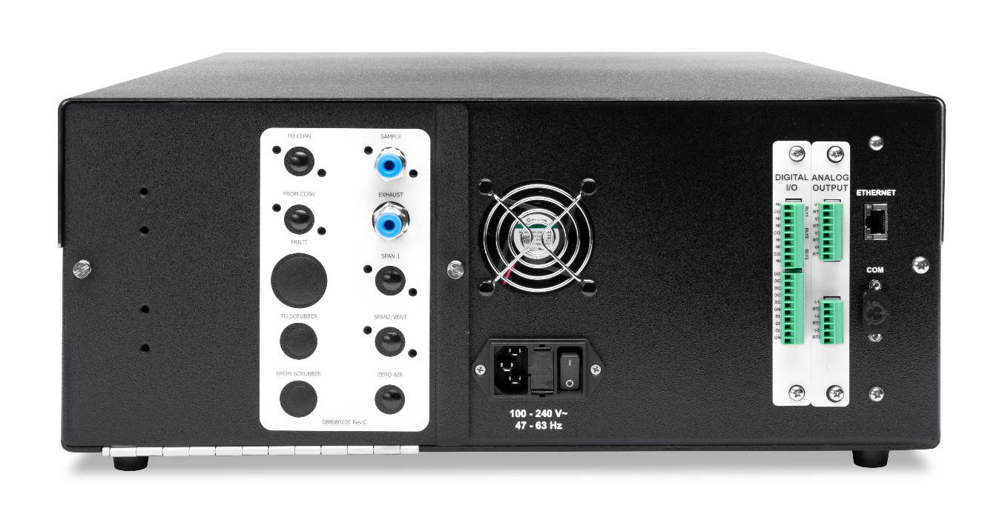
N Series Rear Panel
Split fold-down rear panel
Robust pneumatic bulkhead fittings
Ethernet and serial communications with Modbus protocol
Analog output and Digital expansion cards (optional)

Slide 9
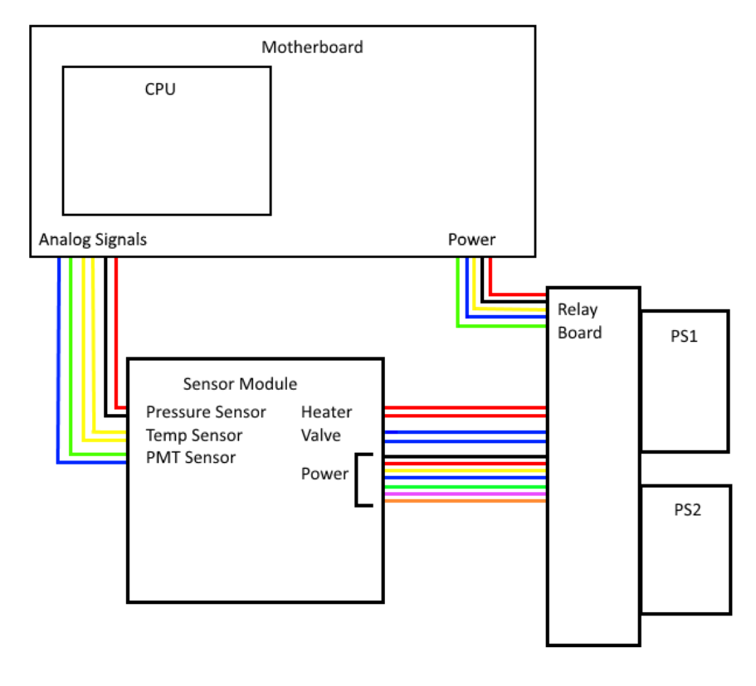
Traditional Gas Instrument Wiring Architecture
Requires host controller (motherboard)
Multiple power supplies
Relay board to transmit power
Analog signals transmitted separately
Many, many electrical connections and variable cable styles

Slide 10
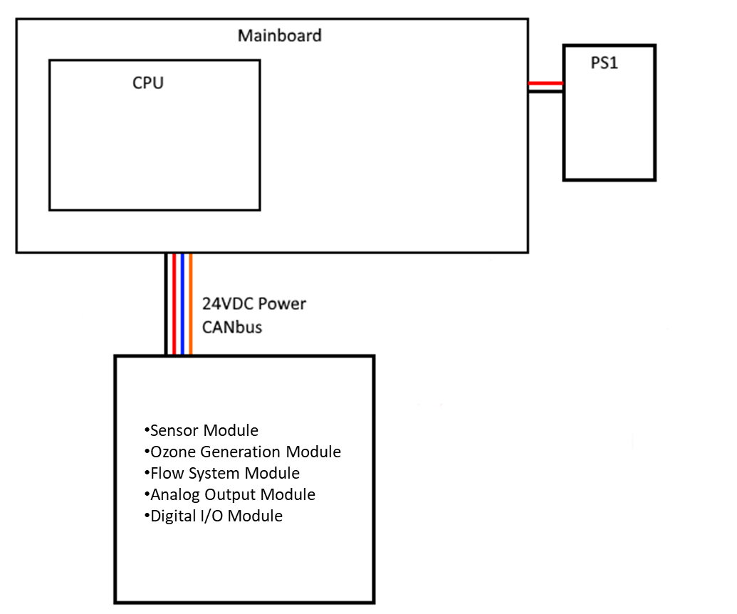
N Series Wiring Architecture
Single, universal power supply
Power and data provided in a single cable set
All CAN Bus cables and connectors are common
Simplified cabling and connections = improved reliability!!

Slide 11
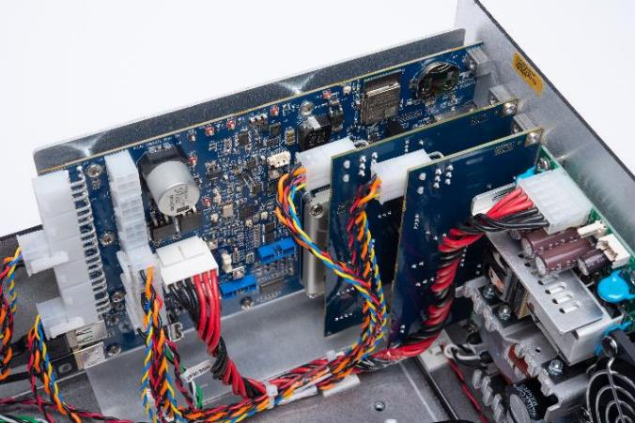
Common Smart Modules
Mainboard Module
  — Serves as the “carrier board” for the CPU
  — Provides the core set of user-accessible I/O, including Ethernet and Serial ports
  — DC power distribution and CAN bus hub
  — Provides all power management including soft power switch
Communication Modules
  — Digital I/O expansion
    Status out, control in, alarm relays
  — Analog outputs
    3 x current (4-20 mA)
    4 x voltage (5 or 10V)

Slide 12
N Series CEM Instrument Models

Slide 13
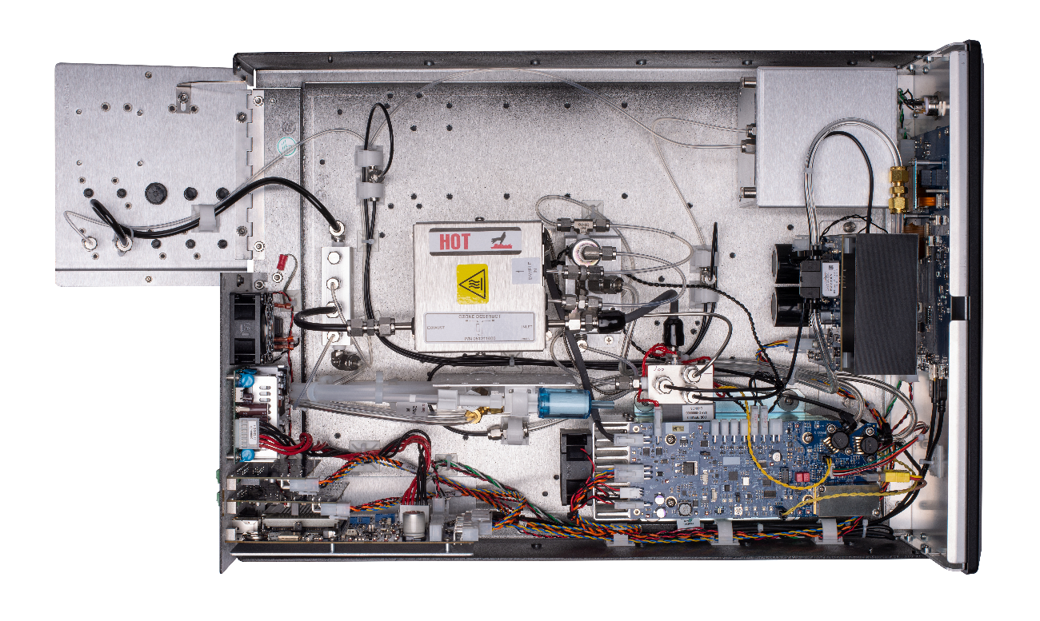
Internal Layout (N200M)
Split fold-down rear panel
Optional integrated paramagnetic O2 sensor
Ozone generator smart module
Common electronics with a single 24VDC power supply
Sensor smart module

Slide 14
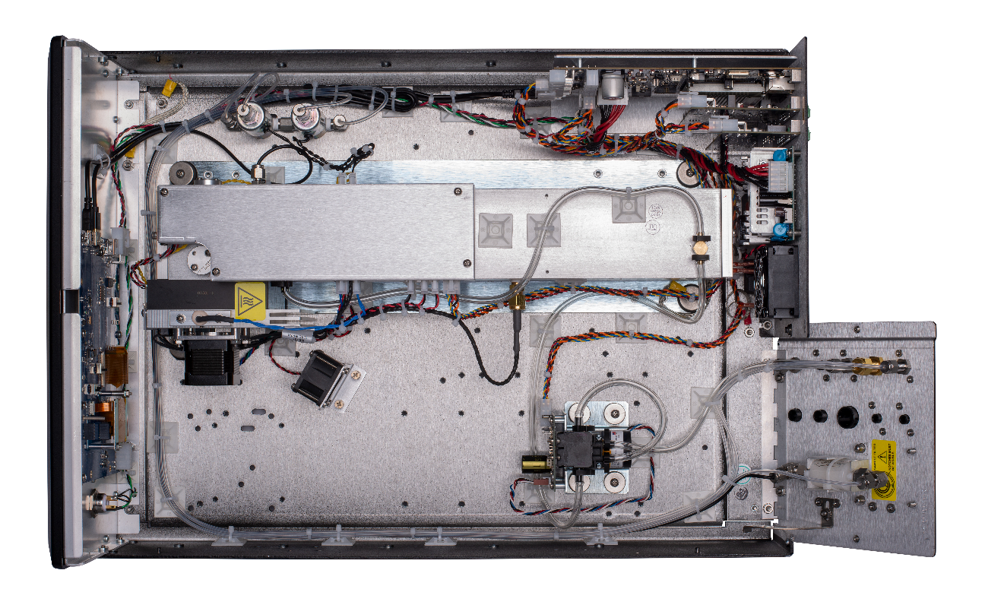
Internal Layout (N300)
Internal Zero/Span Valve Assy*
*options available on ambient models
Long-life or 47mm sample filter holders*
Flow system smart module with Pulse-width modulated (PWM) control

Slide 15
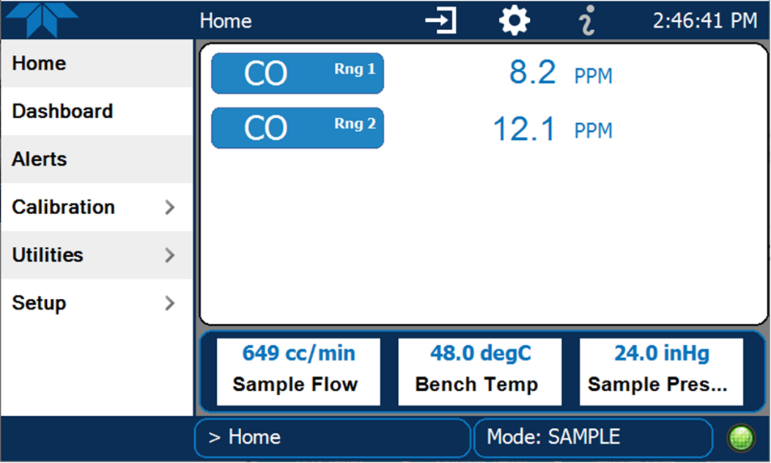
NumaViewTM Software Interface
  Customizable, content rich, and intuitive user interface
User-definable meter variables

Slide 16
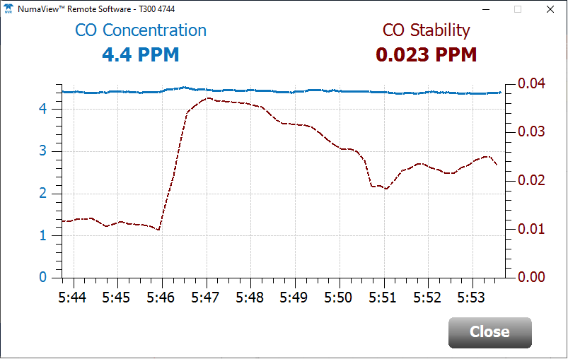
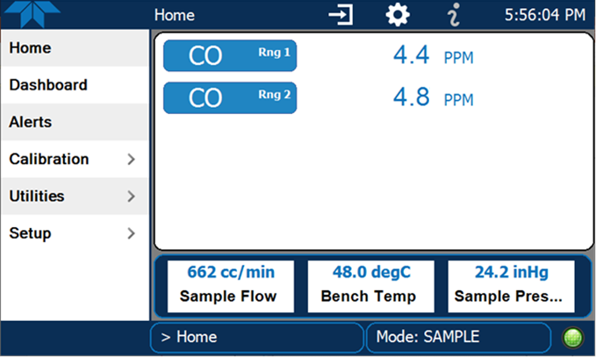
Intuitive User Interface
  Real-time graphical representation of concentration and stability

Slide 17
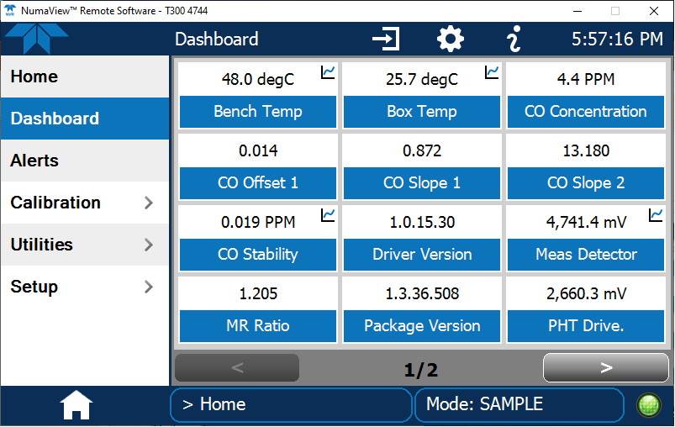
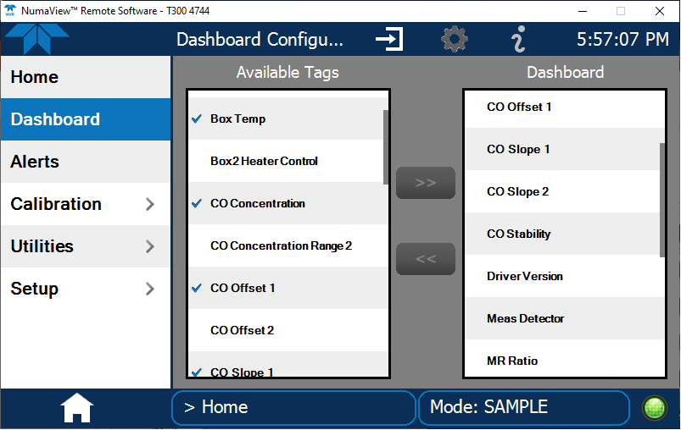
Intuitive User Interface
  Fully configurable dashboard

Slide 18
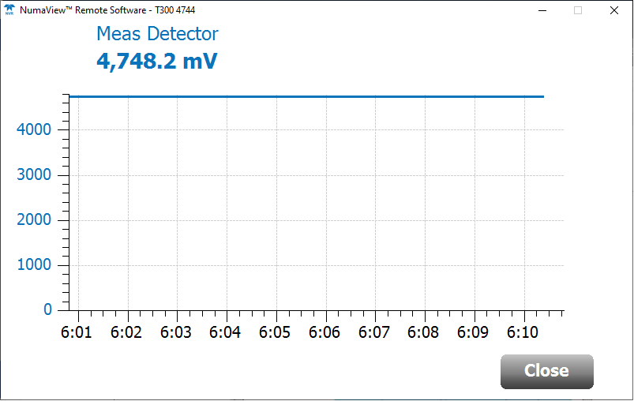
Intuitive User Interface
  Real-time graphical representation of test functions

Slide 19
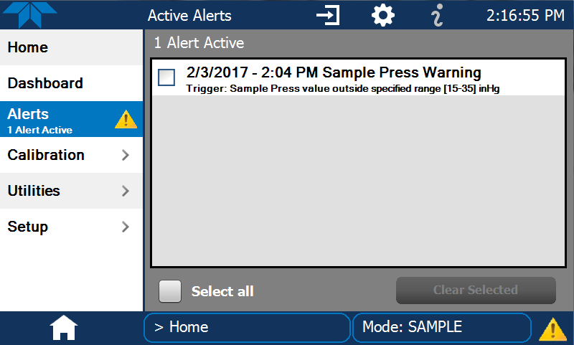
Intuitive User Interface
  Simultaneous display of all active alerts with time stamp and cause

Slide 20
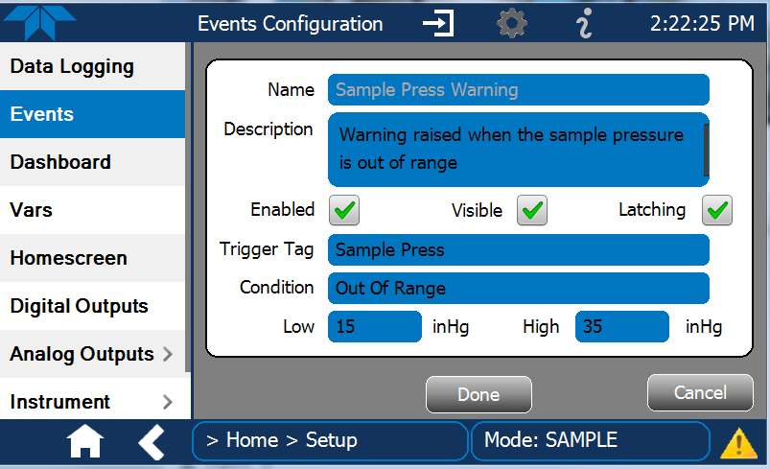
Intuitive User Interface
  Custom events and warnings

Slide 21
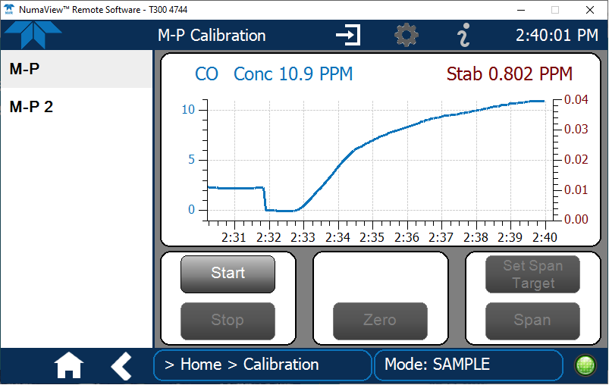
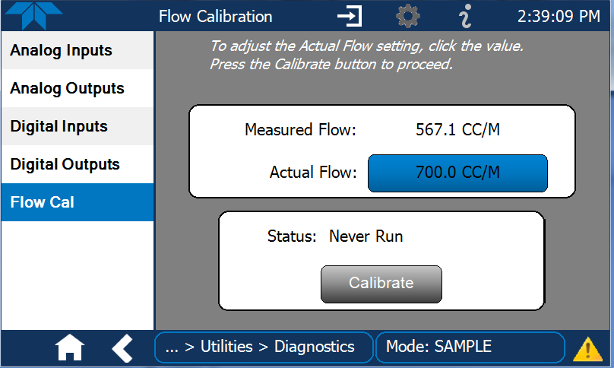
Intuitive User Interface
  Simple Calibrations

Slide 22
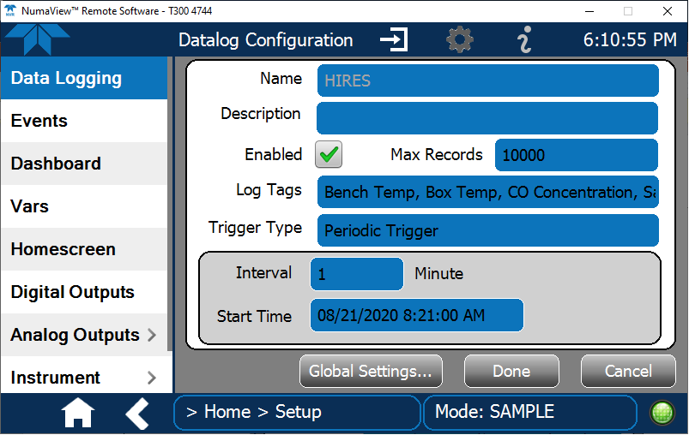
Data Acquisition and Logging
  Triggers for data logging, including periodic and conditional

Slide 23
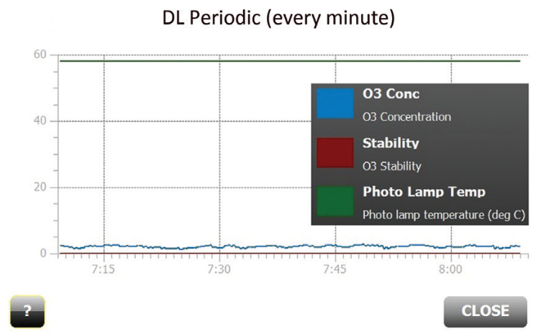
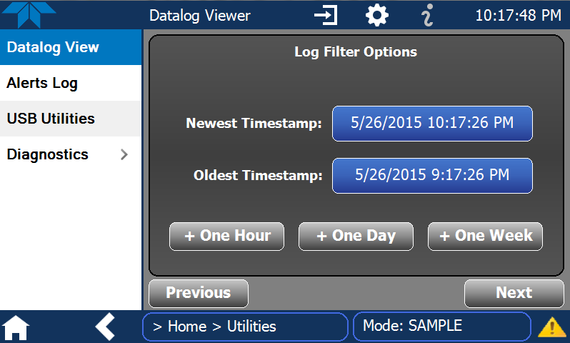
Data Acquisition and Logging
  Customizable datasets that can be viewed on the GUI

Slide 24
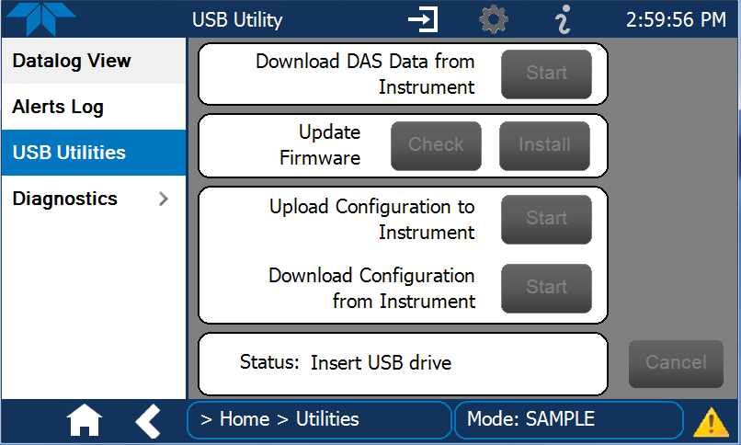
Full USB Support
  Data Upload and Download

Slide 25
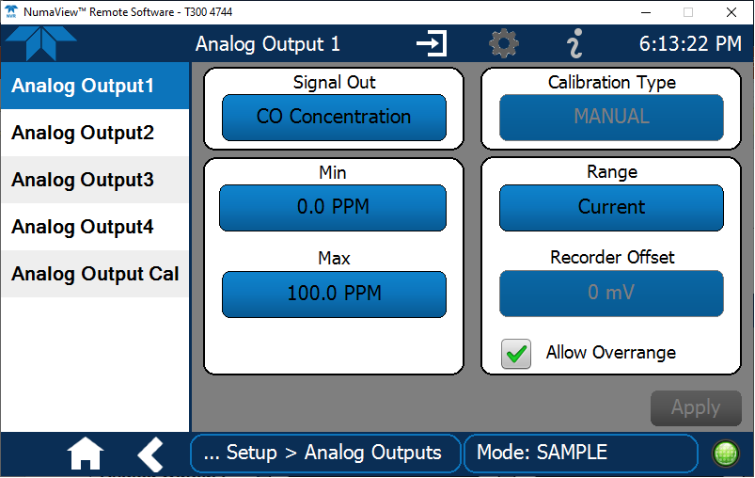
Analog Outputs
  Easily map any data ‘tags’ to any analog output

Slide 26
Teledyne API N Series Gas Analyzers
Designed for today, prepared for tomorrow

Slide 27
T Series… Stack Instruments
T100 SO₂ Analyzer
T100H High-Level SO₂ Analyzer
T101 H₂S Analyzer
T102 TRS Analyzer
T108 Total Sulfur Analyzer
T200 Low-Level NO_{x} Analyzer
T200M Mid-Level NO_{x} Analyzer
T200H High-Level NO_{x} Analyzer
T300U Ultra Low-Level CO Analyzer
T300 Low-Level CO Analyzer
T300M Mid-Level CO Analyzer
T360 CO₂ Analyzer
T360M Mid-Level CO₂ Analyzer
T802 Oxygen Analyzer*
Optional Paramagnetic O₂ Sensor
*Optional NDIR CO₂ Sensor

Slide 28
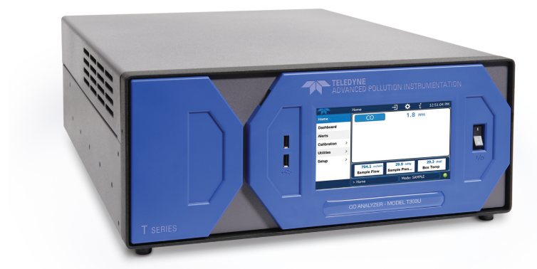
T Series CO Instrument Models
T300U
  Range: 0 -100 ppm
  LDL: < 20 ppb
T300
  Range: 0 – 1,000 ppm
  LDL: < 0.04 ppm
T300M
  Range: 0 – 5,000 ppm
  LDL: 0.2 ppm

Slide 29
T Series NOx Instrument Models
T200
  Range: 0 – 20 ppm
  LDL: 0.04 ppb
T200M
  Range: 0 – 200 ppm
  LDL: 40 ppb
T200H
  Range: 0 – 5,000 ppm
  LDL: 40 ppb

Slide 30
Choosing a NO_{x} Converter
SAMPLE
MOLY
ANALYSIS
PUMP
For ambient applications, the choice is simple: Use a molybdenum catalytic converter, heated to 315ºC. This will convert >98% of the NO₂.

Slide 31

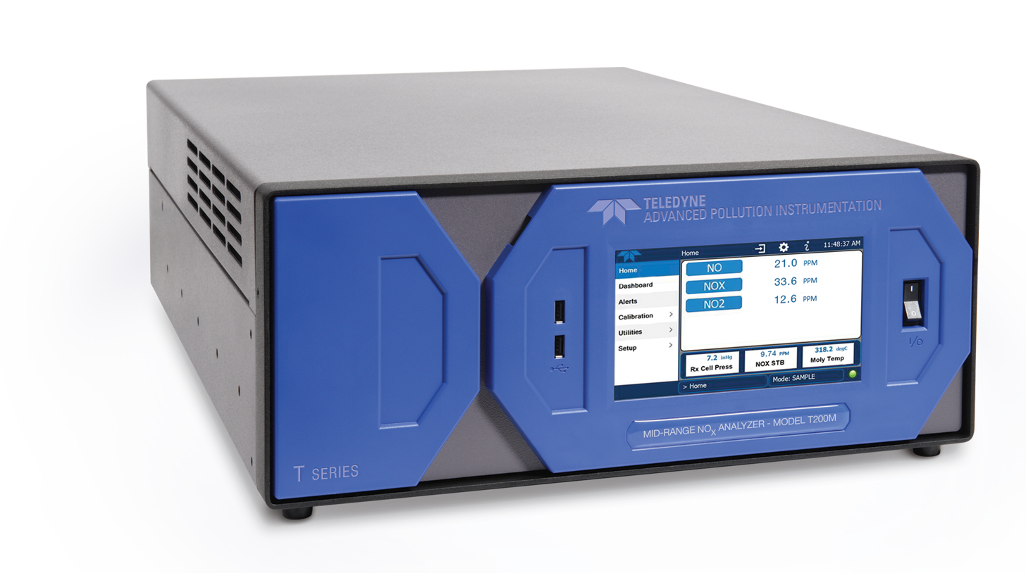
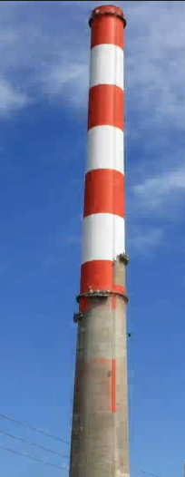
Choosing a NO_{x} Converter
T200M
The choice, when sampling stacks, requires a little thought. First you need to determine the level of NO₂ that you expect the analyzer to see. Typically, the hotter the combustion process, the more NO₂ will be produced.

Slide 32
Choosing a NO_{x} Converter
Probe
Heated Sample Line
Sample Conditioner
T200
Sample Pump
RULE #1: If the expected NO₂ concentration in your straight-extractive system is less than 5 ppm, and the total NO_{x} is less than 10 ppm, use a Model T200 with an internal molybdenum converter. If it is greater than 5 ppm and less than 100 ppm, use the Model T200M or T200H with a moly.

Slide 33
Choosing a NO_{x} Converter
Probe
Heated Sample Line
Sample Conditioner
T200H
Sample Pump
RULE #2: If the expected NO₂ concentration in your straight-extractive system is greater than 25 ppm, and you can tolerate conversion efficiencies as low as 85%, use the Model T200H with an internal “Mini-Hicon”, a stainless steel, high-temperature converter.

Slide 34
Choosing a NO_{x} Converter
In summary, for straight-extractive systems:
[NO₂] < 5 ppm & [NO_{x}] < 20 ppm & Efficiency >98%
Analyzer = Model T200, Converter = Moly
[NO2 ] > 5 ppm and < 100 ppm & Efficiency >98%
Analyzer = Model T200H or T200M, Converter = Moly
[NO₂] > 25 ppm & 85% < Efficiency <100%
Analyzer = Model T200H, Converter = Mini Hicon

Slide 35
Final Test Validation Sheet

Slide 36
Health Status Report
New Health Status Report for a quick snapshot of analyzer operational ‘health’

Slide 37
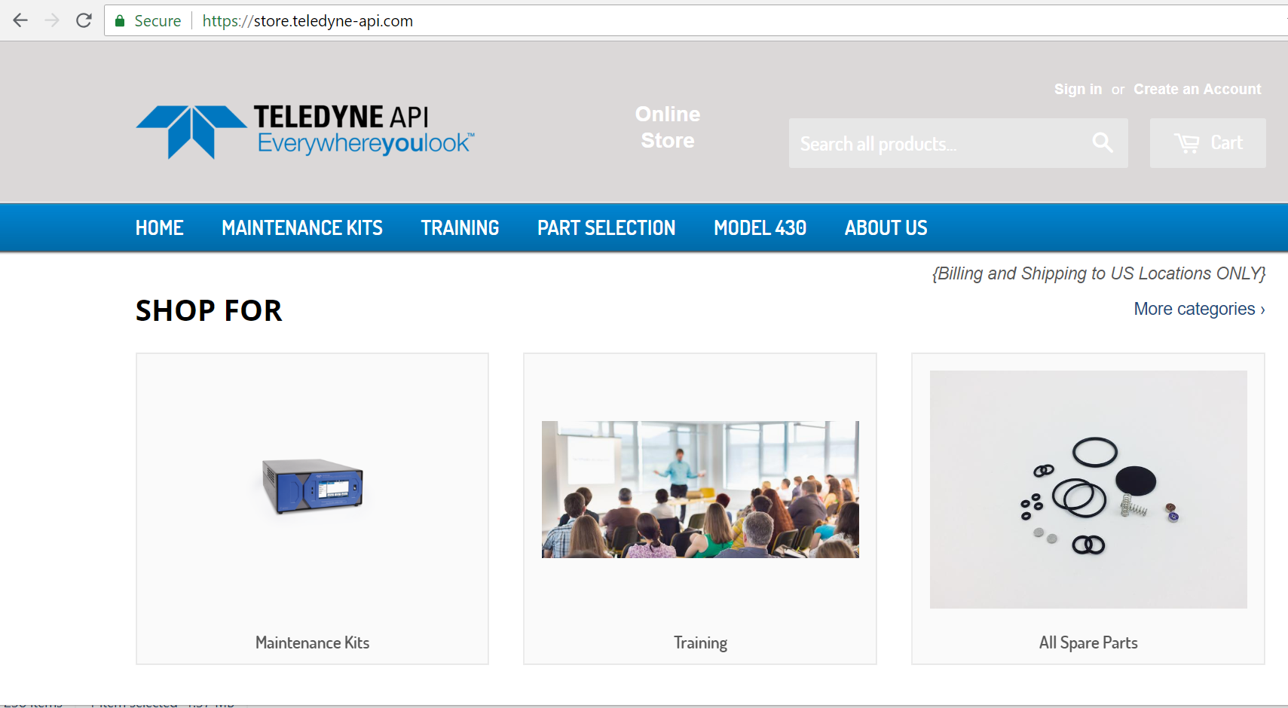
New Webstore
Purchase spare parts, maintenance kits and training with a credit card
store.teledyne-api.com

Slide 38
TAPI Tech Support
No charge for the life of the instrument
Email: API-techsupport@teledyne.com
Phone: 1-858-657-9800
Secure Support:
  http://eservices.teledyne-api.com/services/Users/user_login.asp
RMA or field service request
  http://www.teledyne-api.com/service-support/rma

Slide 39

Questions?

