Slide 1
Tube Bundle
Sample Conditioning & CEMS
Analyzer System Solutions

Slide 2
Agenda
Thermon Overview – background and update
Lead times/Supply Chain
Design/Build Considerations
Accessories/System solution
Proper installation techniques/Site Services
Power Blankets

Slide 3
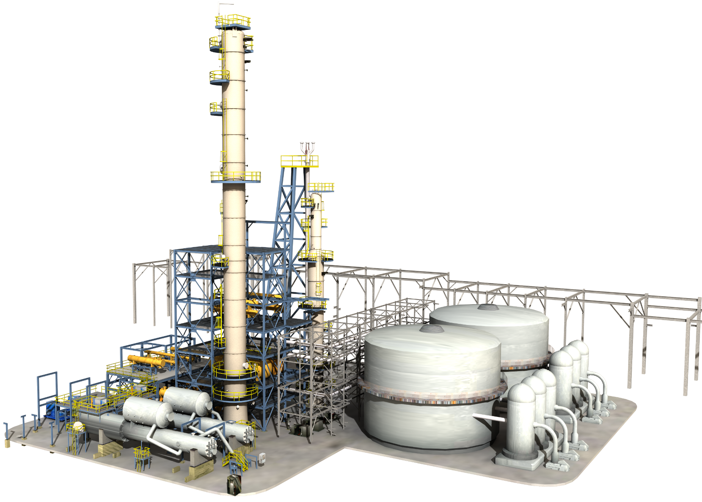
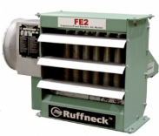
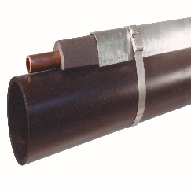
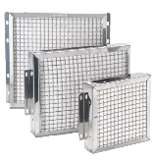
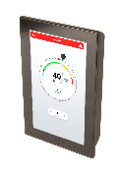
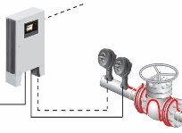
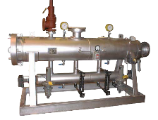
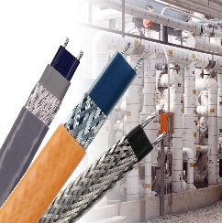
Industrial Process Heating
Thermon now offers heating solutions for the external and internal maintenance of process temperatures in critical applications, while including advanced controls and communications platforms to add more value for our end customers
Electric Air Heating
Analytical & Emission Monitoring Bundle
Steam Heat Tracing Solutions
Gas Catalytic
Heating
Market-leading IIoT Communication Software & Controls
Engineered Heating & Filtration Systems
Electric Heat Tracing Systems
Immersion Heating

Slide 4
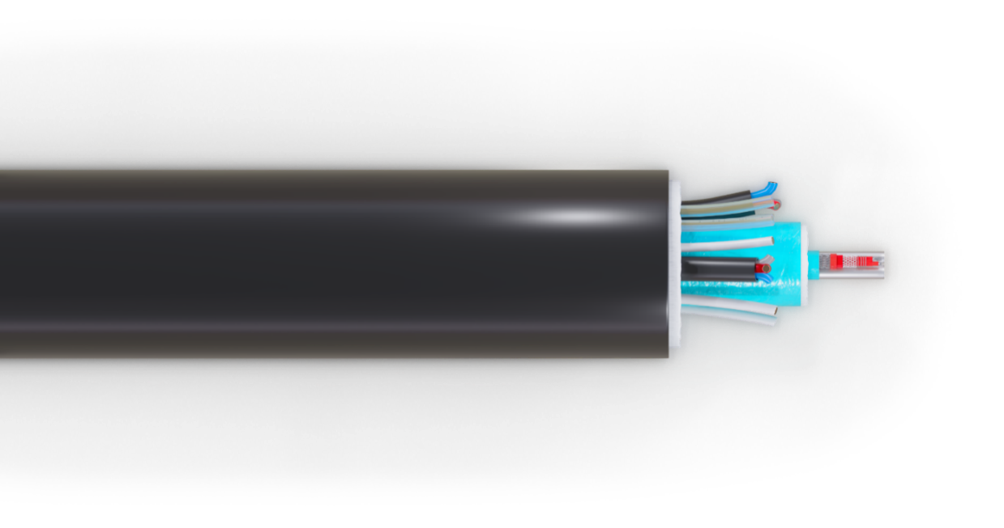
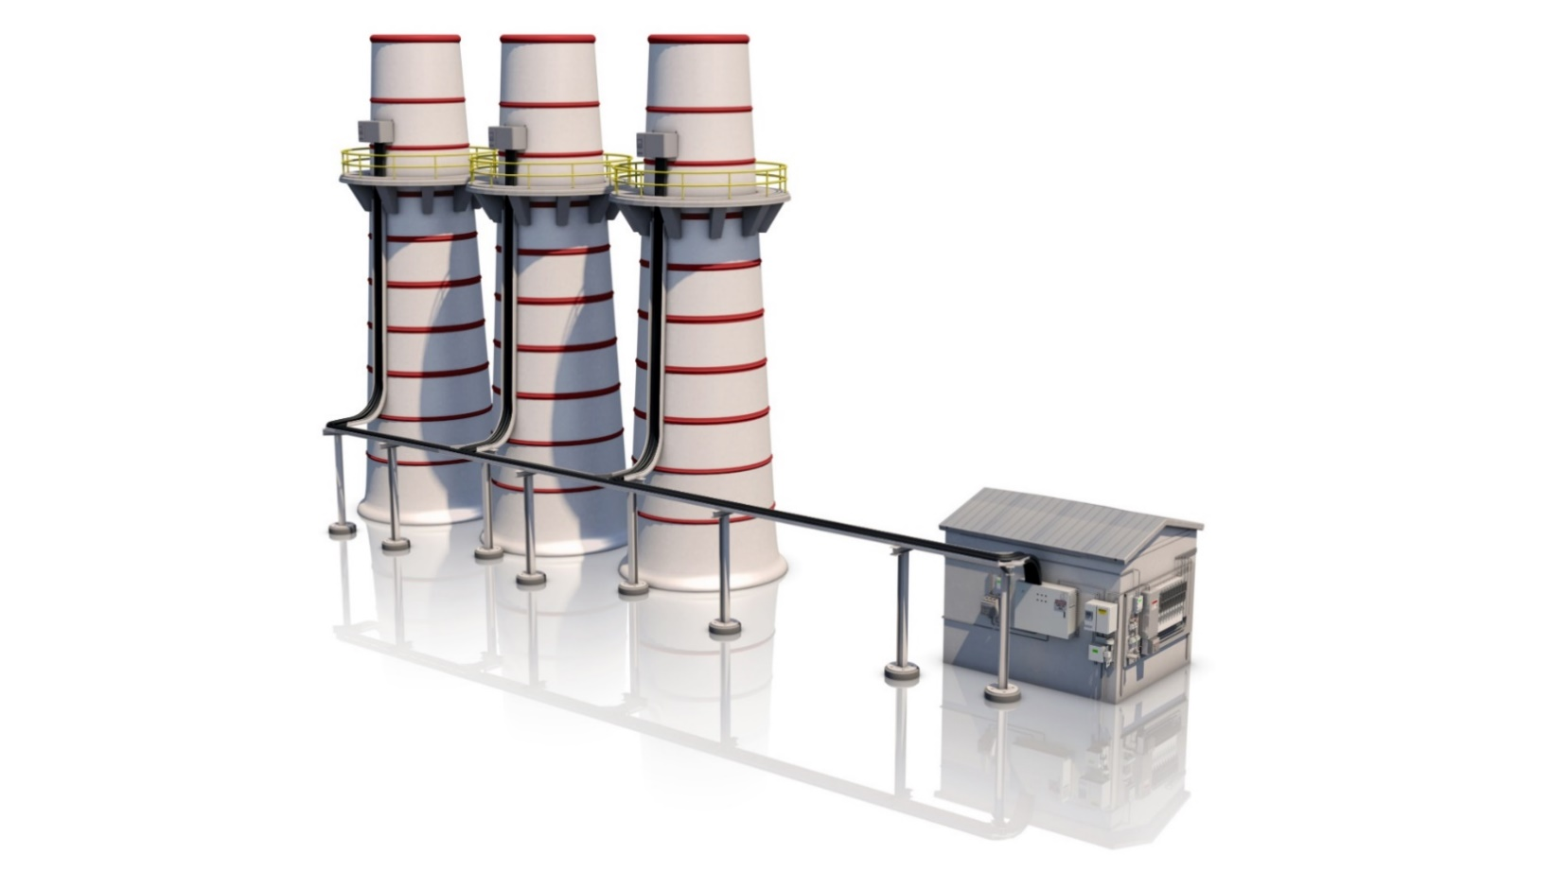
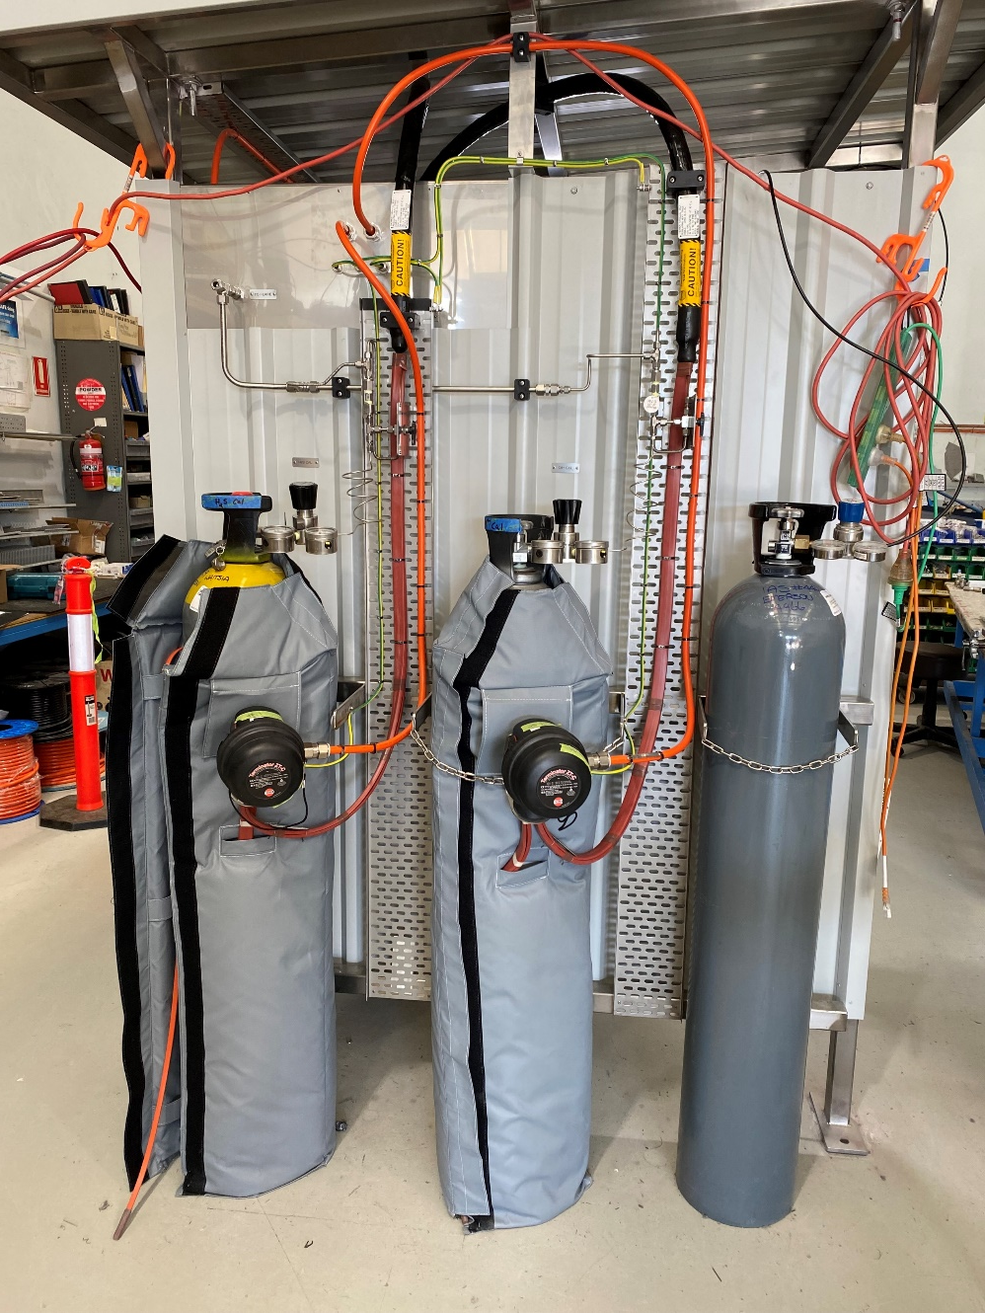
CEMS Umbilical
Monitoring Processes
Dilution Systems – Freeze Protection
Hot Extractive Systems – Temperature Control
SOx, NOx, CO, Hg and others

Slide 5
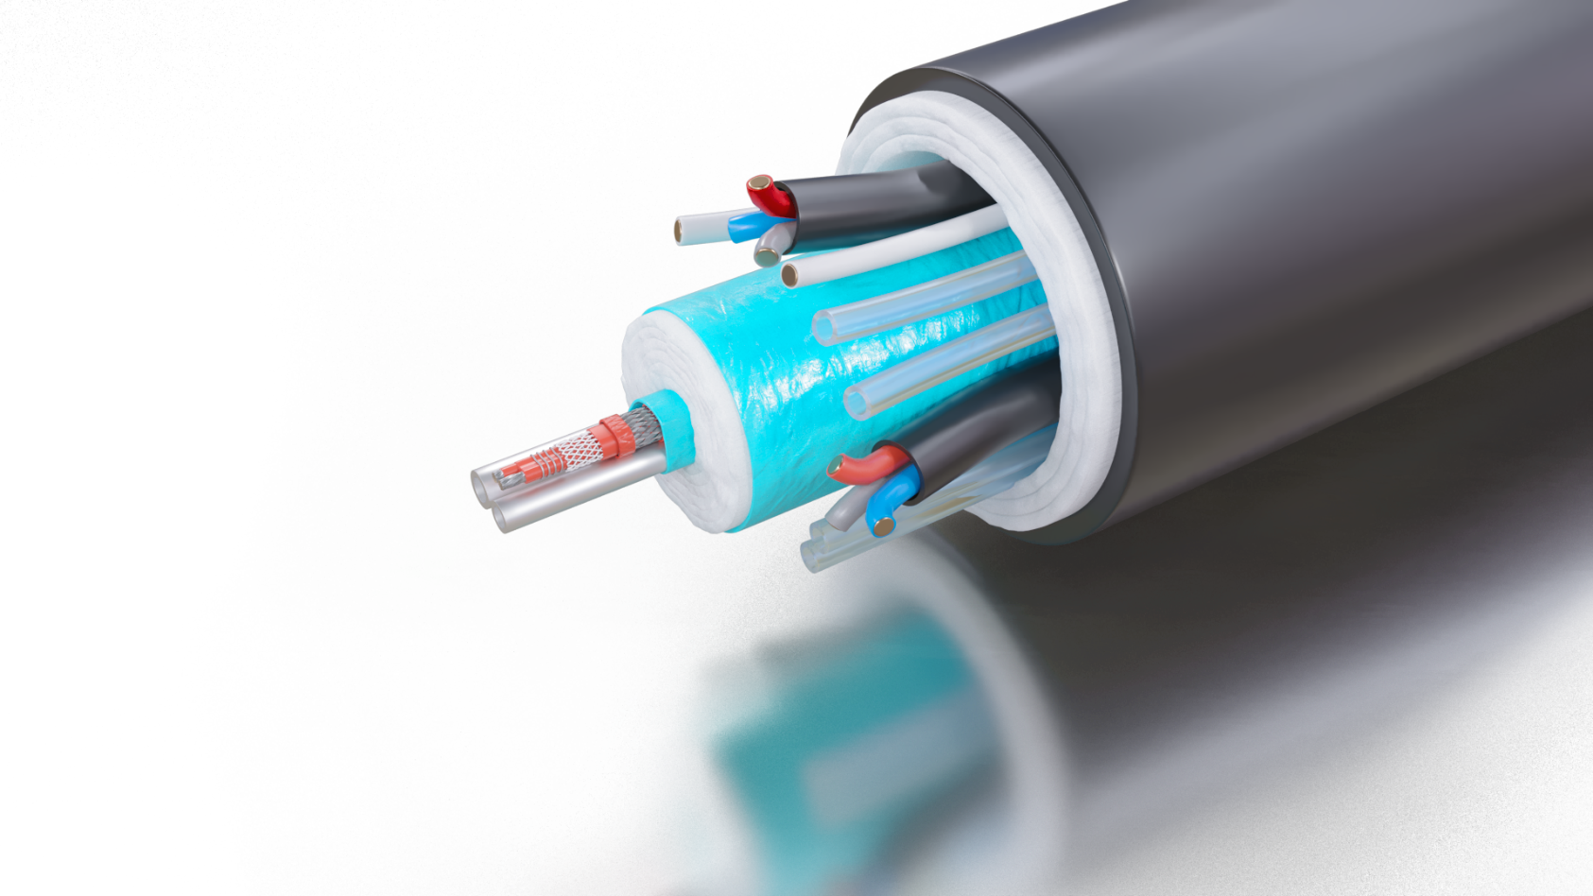
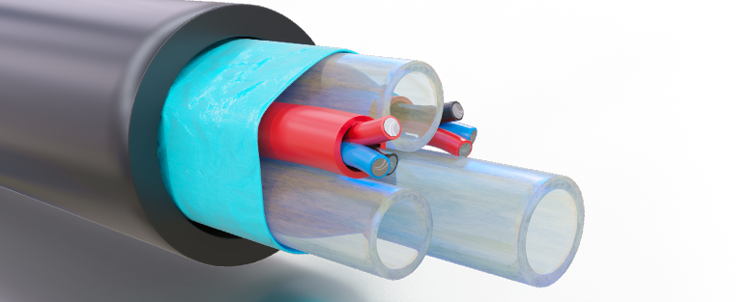
Supply Chain / Lead Time Update
Our supply team has filled the raw material shelves with the most common tubes needed, including seamless and welded stainless steel, copper, Alloy 825 and Fluoropolymer tubing. In addition, we have built up stock on our most popular heating cables, such as BSX, HTSX and HPT. Our operations management has prepared skilled and cross-trained personnel, using world class process improvement techniques, which has opened capacity for the return of our Quick-Ship-Program**.
For bundle needs up to 1000 ft quantity: (For larger demand, confirm with factory)*
• Self-regulating/HPT bundles: Standard 2-3 wks. Quick-Ship 5-7 workdays $350 fee
• SE/ME – XINS bundles: Standard 3-4 wks. Quick-Ship 1-2 weeks $500 fee
• Light & Heavy steam trace: Standard 2-3 wks. Quick-Ship 5-7 workdays $350 fee
• High temp., HT, HTX & HTX2: Standard 3-4 wks. Quick-Ship 1-2 weeks $500 fee
• Price listed SL ThermoTube®: Stock-1 week
• CEMS Bundles: 4 weeks with expedite options
• SafeTrace bundles: Contact factory for available stock & lead-time
Supply Chain:
SS Tubing
Silicon
Heater cable components
PFA?

Slide 6
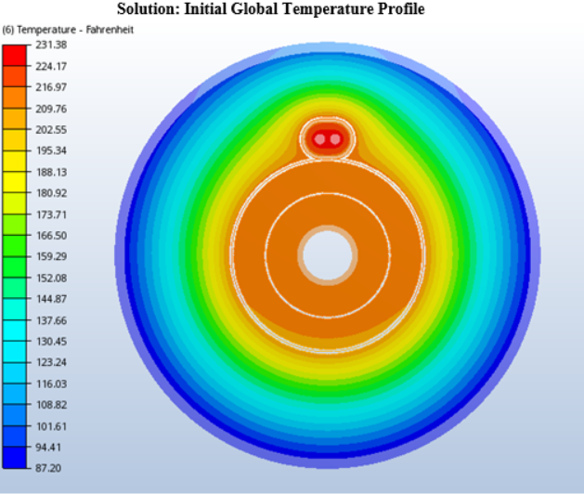
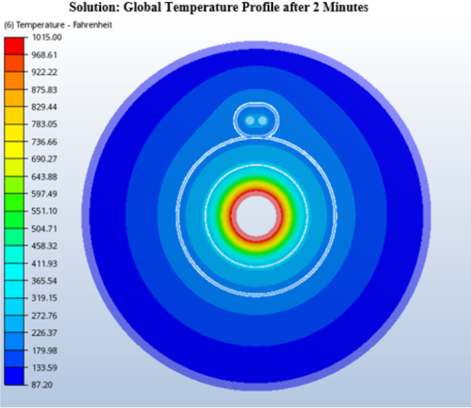
Thermal Design Challenges
Maintain the process fluid temperature
At the lowest specified ambient condition
Don’t overheat process fluid temperature
At the highest specified ambient condition
While keeping the tube bundle surface temperature within personal protection codes, 60°C or below.
Keep the product surface cool to touch
Don’t overheat the core
Maintain Process Tube Temperature

Slide 7
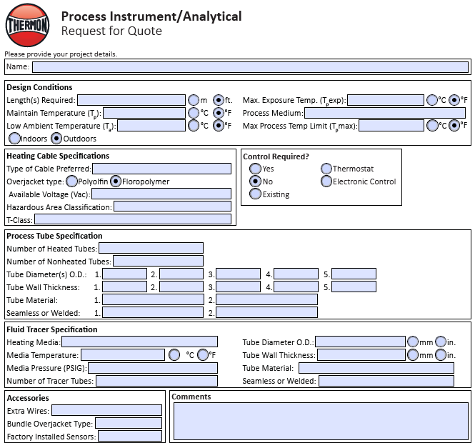
Design Considerations
Critical System Design Criteria
Tube Material & Treatments
Tube Size
Sample Point Installation Lengths
Operating Voltage
Hazardous Area Classifications
Temperature to be Maintained
Ambient Conditions
Low - Winter
High - Summer
Max. Process Exposure Temperature

Slide 8
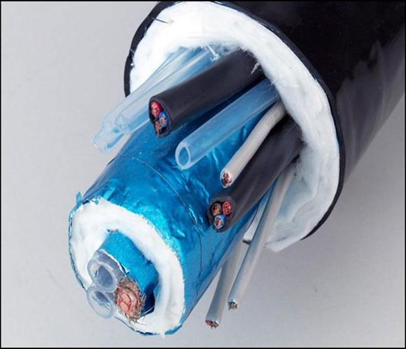
Design Considerations continued
Optional Design Needs
Embedded RTD or Thermocouple
Instrument wires for remote valve control.
Power wire needs for probe heaters and/or sample conditioning support
Unheated tubes for blowback & calibration of the analyzer

Slide 9
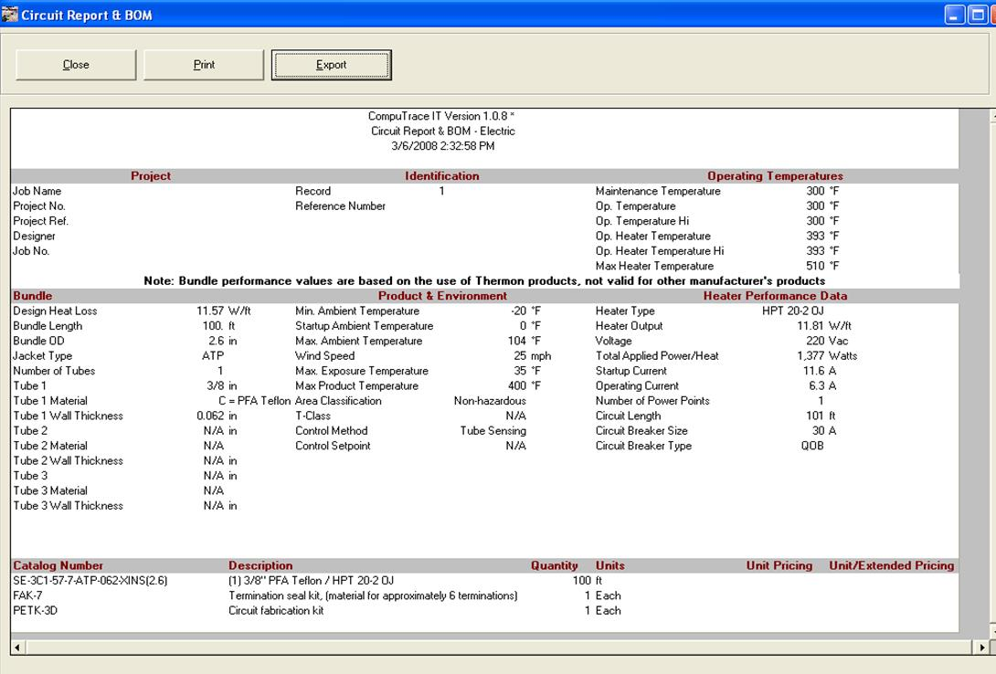
Design Circuit Report – CompuTrace IT

Slide 10
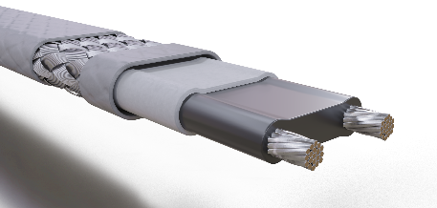
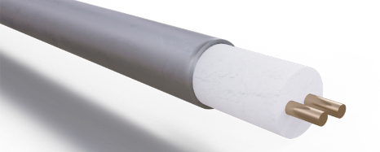
The Engine of Thermal Success Premier Heating Solutions
HTSX Self-regulating
Max. Maintain Temp: 302°F (150°C)
Max. Exp. Temp.: 400°F (205°C) (power-off)
Fluoropolymer Jacket
Up to 20 watt/ft & 277V Ratings
Ordinary & Haz., Location Ratings
Cut-To-Length in Field
BSX Self-Regulating
Max. Maintain Temp: 150°F (65°C)
Max. Exp. Temp.: 185°F (85°C) (power-off)
Polyolefin or Fluoropolymer Jackets
Up to 10 watt/ft & 277V Ratings
Ordinary & Haz., Location Ratings
Cut-To-Length in Field
HPT power-limiting
Max. Maintain Temp: 410°F (210°C)
Max. Exp. Temp.: 500°F (260°C) (power-off)
Fluoropolymer Jackets
Up to 20 watt/ft & 240 Ratings
Ordinary & Haz., Location Ratings
Cut-To-Length in Field
MIQ Constant watt
High Temp Mineral Insulated Cable
Not Cut-to-Length
Maintain up to 500℃ (932℉)
Max exposure 600℃ (1,112℉)
Ordinary & Haz., Location Ratings
Metallic outer cover

Slide 11
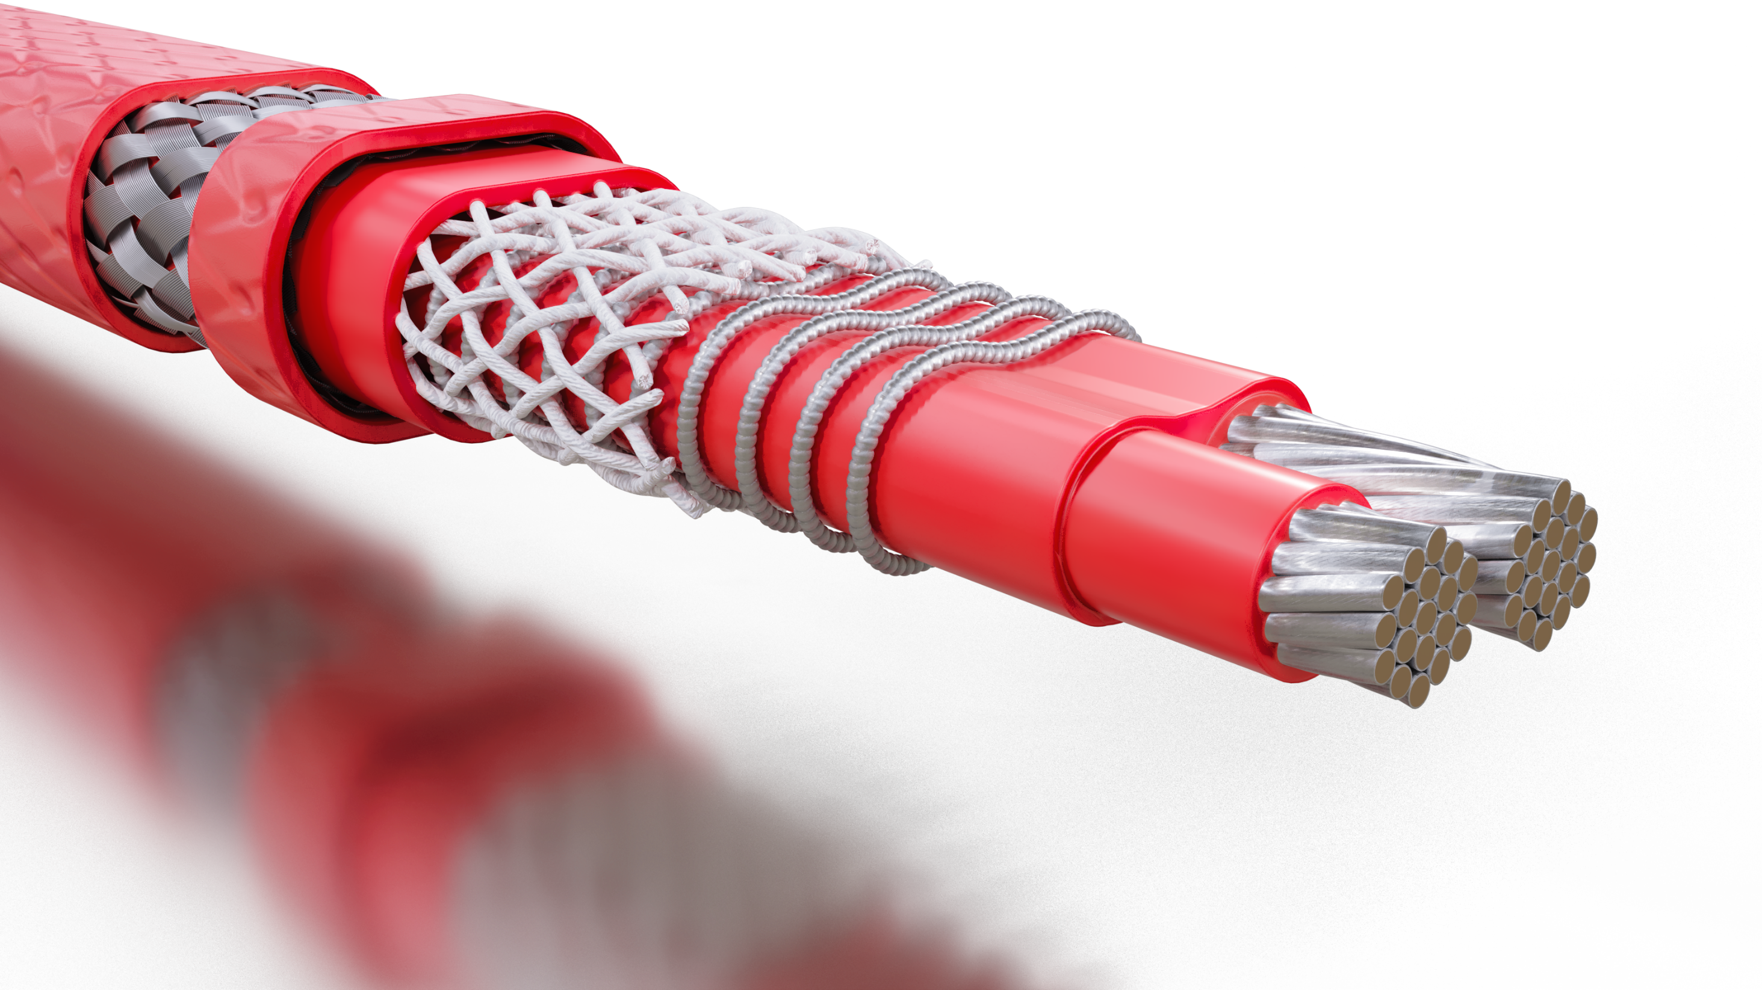
HPTTM and HPT XRTM Power-Limiting Heating Cable
FEATURES
Medium to high process temperature maintenance
Steam clean/purge
Certified for use in ordinary (nonclassified) areas and in potentially explosive atmospheres

Slide 12
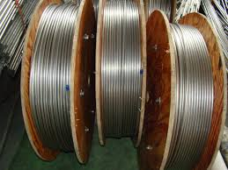
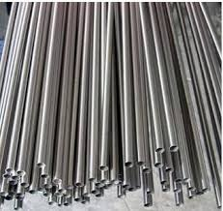
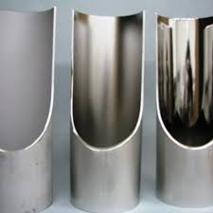
Tubing Standards
316/316L Dual Certified UNS S31603
Seamless or Welded
ASTM A269/A213 EAW
90 HRB Max – Fully Annealed
NACE MR0175-MR0103
100% PMI Certified by Heat Number at the Mill.
100% Hydrostatic Tested per A1016/A1016M
MTR’s Available upon request with orders. No charge
Full – PMI test reports available at an additional charge, per % of lot-number.
EP – Electropolishing ASTM B912
30µ-in Ra ID to 10µ-in Ra ID
Chemical Passivation
Sulfinert Treatments
Long Coil Length
20 ft Stick Length
Electropolished

Slide 13
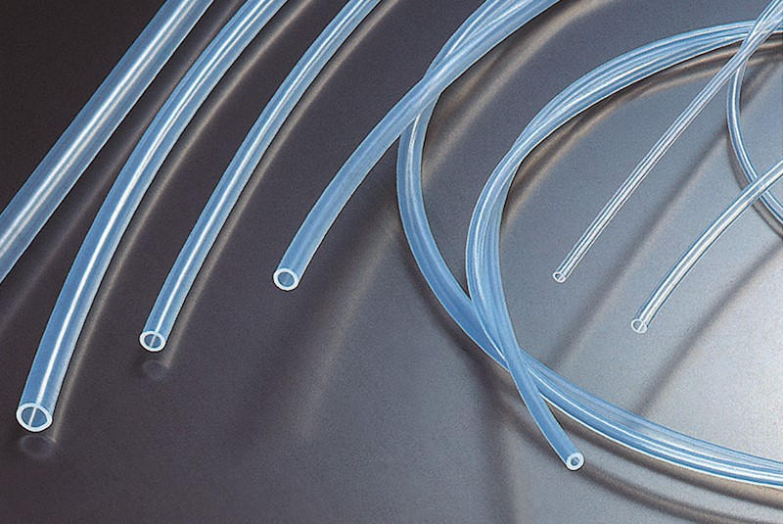
Tubing Selection
PTFE
Temperature Rating: 500°F Continuous
Flexible
Low Permeability
Excellent Chemical Resistance
Shorter Length Limitation
Semi-Opaque
PFA
Temperature Rating: 500°F Continuous
Good Flexibility
Lower Permeability than FEP
Excellent Chemical Resistance
Long Lengths
Translucent
UHP PFA
Temperature Rating: 500°F Continuous
Excellent Flexibility
Highest Thermal Stability
Lowest Permeability (even with HCL)
Excellent Chemical Resistance
Long Lengths
Highest Purity Levels
Translucent
FEP
Temperature Rating: 400°F Continuous
Good Flexibility
Low Permeability
Good Chemical Resistance
Long Lengths
Excellent Clarity
100% Pure Fluoropolymer Tubing

Slide 14
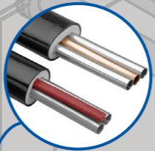
Cabled 360° - Ideal Engineered Thermal Performance
Ease of Bending in any Plane or Direction
Provides Stress Relief for Components in Bundle
Reduces Likelihood of Kinks and Cold or Hot-Spots
Better Thermal Performance
Reduced Bend Radius in All Directions
Notes:
Helps manage differences in the coefficient of expansion and contraction between tubes or between heater cable and tubes
Heat transfer to the tubing being heated more uniform along entire length of line.

Slide 15
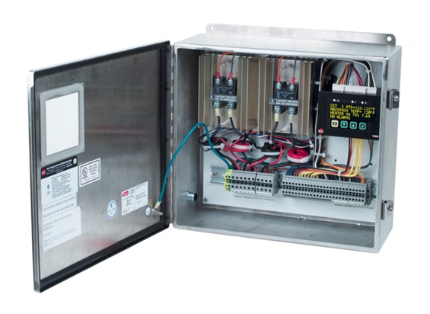
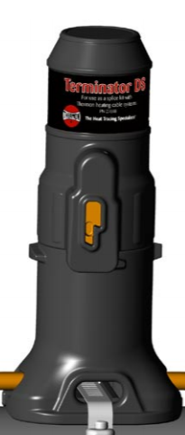
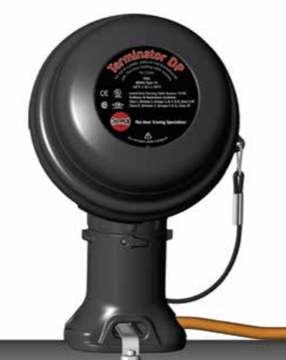
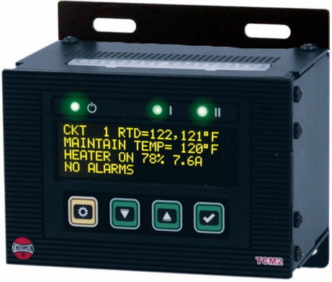
Complete Control & Monitoring Solution

Slide 16
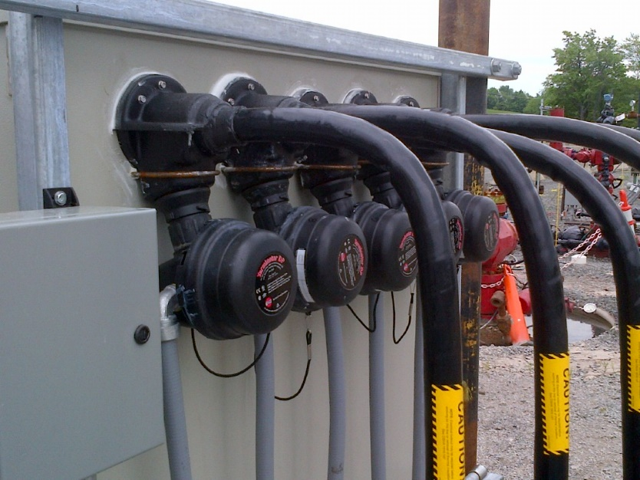
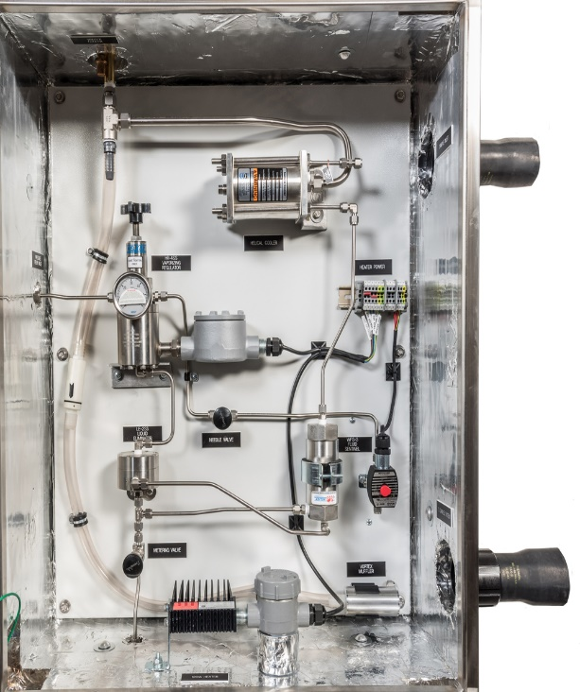
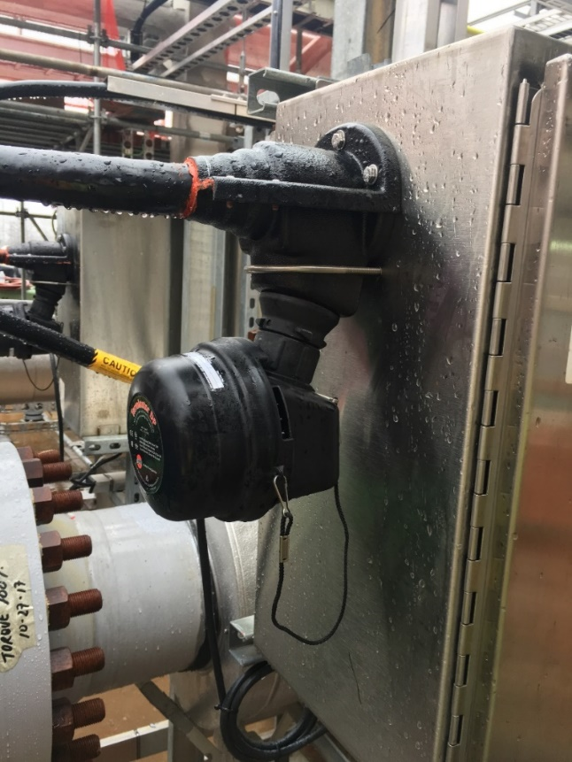
Top In Class Installation Systems
Before Terminator
After Terminator

Slide 17
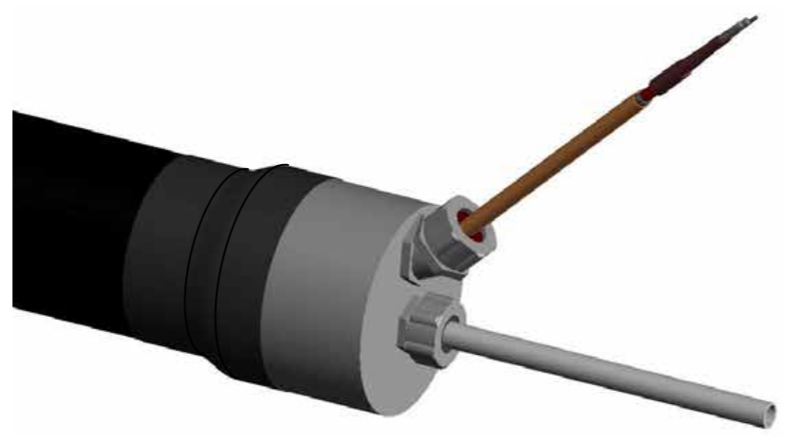
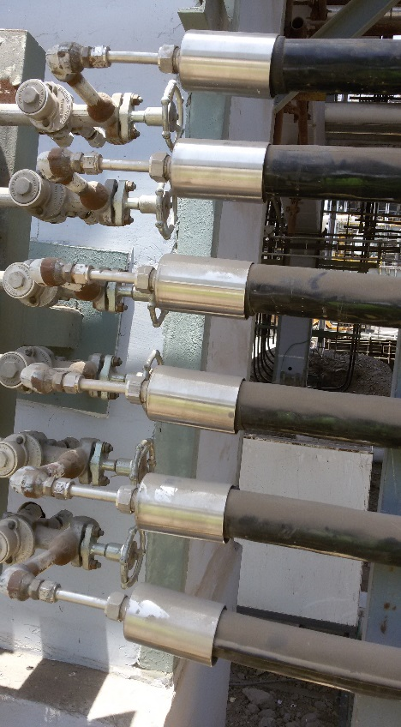
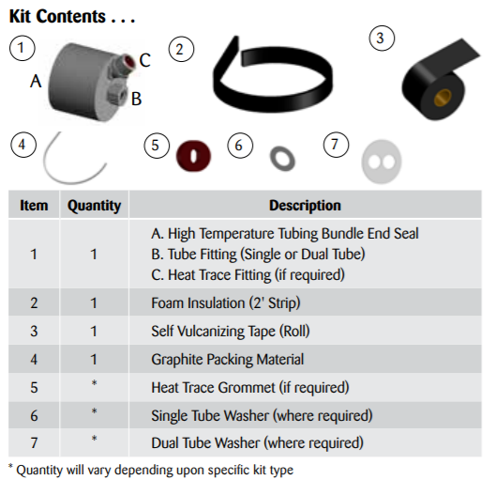
High-Temperature Bundle Seal Kit Designed for high temperature, continuous steam purge applications.

Slide 18
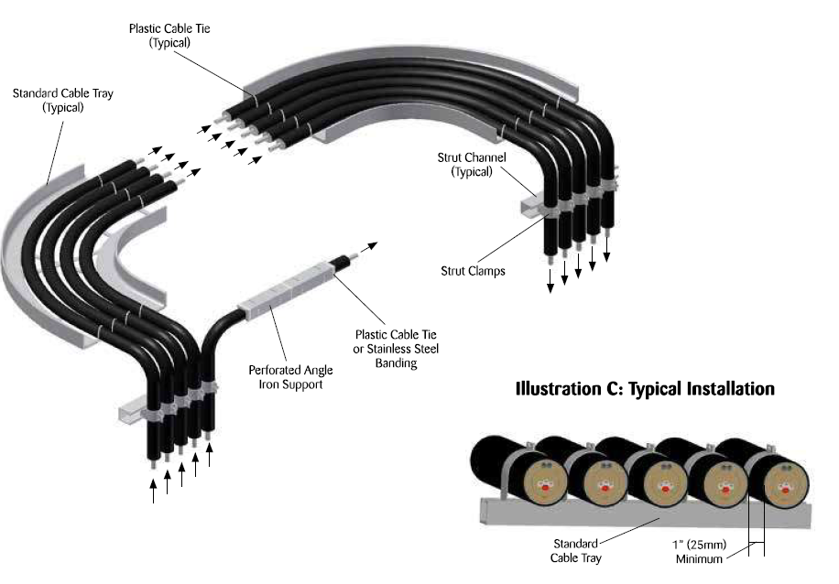
Typical Installation Layout - Multiple Bends – Multiple Directions
Notes:
Installation instructions show how to install properly, and QC the heater during installation.

Slide 19
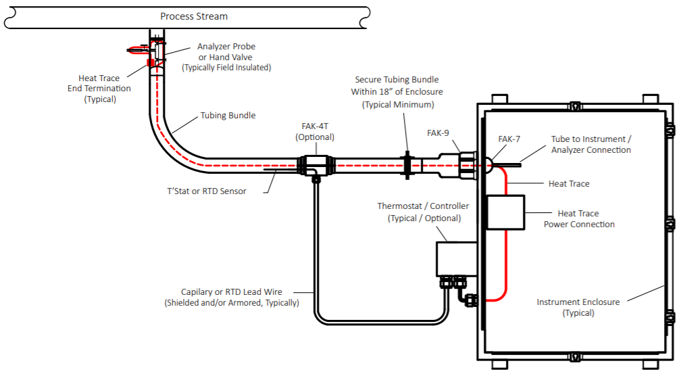
Installation Road Maps
End Seals
Electrical End Termination
Temperature Sensors
Power Connection
Temperature Control Systems

Slide 20
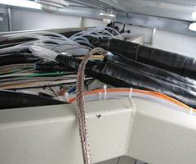
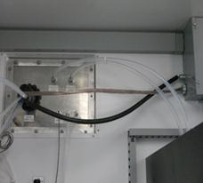
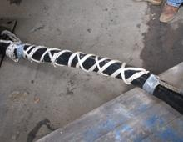
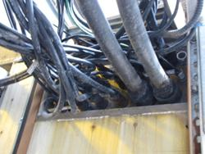
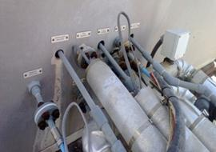
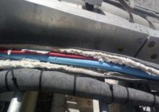
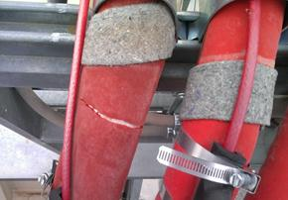
Proper Installation, Care and Maintainence
Don’t take the line for granted
Don’t leave the umbilical ends exposed
Don’t exceed the bend radius – tubes will kink
Don’t tie multiple bundles together
Don’t over-tighten the supports – expansion/contraction
Don’t forget to terminate. Follow proper heater and tubing terminations
Don’t forget to test the heater. Megger test the heater prior to and after install
Don’t forget to record and save the information – test results, manufacturer, line information, etc.
Don’t assume that everything is always alright, do
periodic inspections of the products

Slide 21
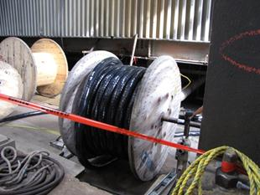
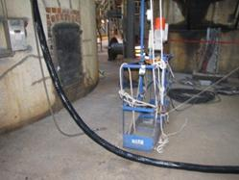
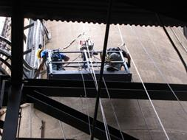
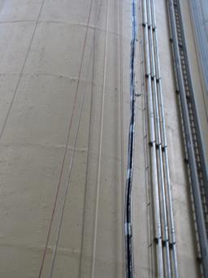
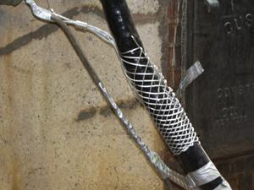
TYPICAL CEMS INSTALLATION DETAILS PULLING SAMPLE LINE UP THE STACK USING A TUGGER

Slide 22
Thermon System Support
Thermal Design engineering
Installation training
Site Supervision
Field Installation service

Slide 24
THANK YOU

