Slide 1
CALIBRATION CHECKS
Presenters:
Clif Petersen – Senior PLC Programmer
Reggie Williams – Environmental Scientist
09/14/2022

Slide 2
How Does Software Validate the Hour
At least 1 valid minute in each of the 15-minute quadrants of each hour.
For hours of calibration or maintenance:
2 valid minutes at least 15 minutes apart.
Minimize downtime:
Allow a valid minute in the quadrant before starting calibration or maintenance.
Schedule long tests; linearity, across the top of the hour.

Slide 3
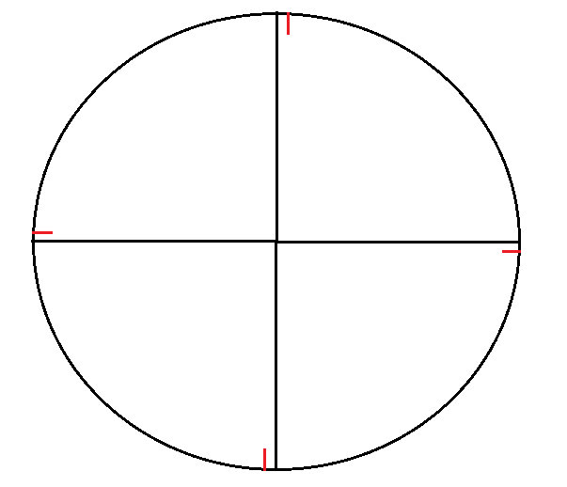
Hour with Quadrants

Slide 4
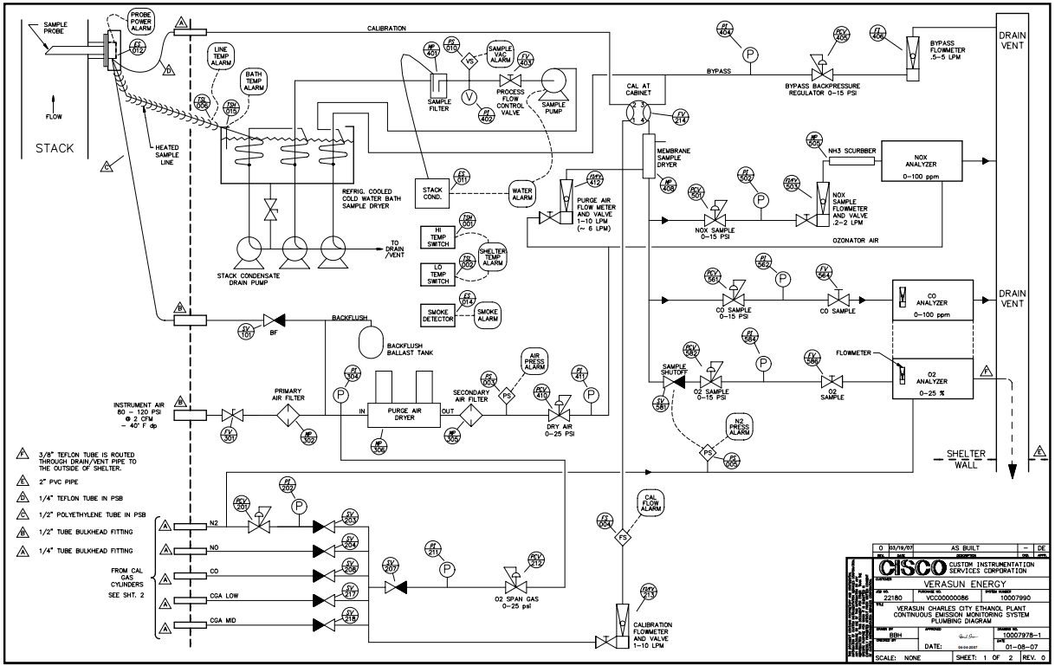
Sequencing of the Calibration Gases

Slide 5
Calibration Timing and Settings
Time of injection is primarily the time it takes for the gas to move through the probe to the analyzer.
Avoid high concentration followed by a lower or zero concentration.
O₂ is easier to zero or span than other analyzers.

Slide 6
TIME
PARAMETER | 40 CFR 60 | 40 CFR 75
7-Day Drift | Approximately 24-hours | Approximately 24-hours (UOD)
Daily Calibration |  | 24 + 2 clock hours
 |  | 24 + 2 UOH hours
Start-up |  | 8-hour grace period

Slide 7
Late or Expired Cals
PARAMETER | 40 CFR 60 | 40 CFR 75
7-Day Drift | Must meet 40 CFR 60, App. B criteria to pass | Must meet 40 CFR 75, App. A criteria to pass
Daily Calibration | Not addressed. EPA v. State | Regulations require data invalidation

Slide 8
Fail Limits
PARAMETER | 40 CFR 60 | 40 CFR 75
7-Day Drift | 1 X Appendix B, PS | 1 X Appendix A, PS or MD
Daily Calibration | 2 X PS – Once (Warning) | 2 X PS – Once (OOC) or MD
 | 2 X PS – 5 times (OOC)
 | 4 X PS- Once (OOC) Fails backwards

Slide 9
Operational Status
PARAMETER | 40 CFR 60 | 40 CFR 75
7-Day Drift | Online | Online
 |  | ≤ 50 ppm exempt
Daily Calibration | Online & Offline | Online
 |  | Online & Offline, if determination test performed

Slide 10
Dual Range Analyzers
PARAMETER | 40 CFR 60 | 40 CFR 75
7-Day Drift | Both ranges must pass, or analyzer is OOC (Guidance) | If one range fails, then analyzer is OOC (Regulation)
Daily Calibration | Online & Offline | Online
 |  | Online & Offline, if determination test performed

Slide 11
Calibration Drift Gas Concentrations
PARAMETER | 40 CFR 60 | 40 CFR 75
Calibration | Zero (0 -20%) & High (50 -100%) | Zero (0 -20%) & Mid (50 -60%) or High (80 -100%)

Slide 12
Instrument Air Usage
PARAMETER | 40 CFR 60 | 40 CFR 75
7-Day Drift | Not addressed in regulations, guidance or determinations | Allowed, but must demonstrate clean of O₂ interferents
Daily Calibration | Online & Offline | Online

Slide 13
Non-Test Errors e.g. Calibrating with cylinders turned off
PARAMETER | 40 CFR 60 | 40 CFR 75
7-Day Drift | Must meet 40 CFR 60, App. B criteria to pass | Does not affect test if a calibration was performed on the same day
Daily Calibration | Not addressed. EPA v. State | Non-test has no impact and should not be reported

Slide 14
Questions?
THE END

