Slide 1
Water Management in Gas Analysis
Laura Geenen +1-848-224-3790
Director of Business Dev. LGeenen@PermaPure.com
Environmental/Scientific Div. www.PermaPure.com

Slide 2
Challenges for CEMS Sample Conditioning
Difficult to sample a hot, wet, dirty and corrosive gas reliably & consistently​
High reliability required – systems must run for a long time without supervision​
Must tolerate adverse and faulty operating conditions​
Hot and Humid ambient conditions (up to 50 C) if installed outside​
Systems require maintenance and sometimes costly repair to maintain compliance

Slide 3
Sample Pathway
H20
H20
Gas
Sample
Cooler
Gas
Sample
Gas
Sample
Analyzer
Polisher
Sample Conditioning Prevents Unexpected Liquid Water!
Why do we care so much?
3

Slide 4
Costs of Unexpected Water
Corrosion
Unplanned Maintenance
Loss of Water-Soluble Components
Inaccurate Analysis

Slide 5
How Wet is Wet?
Relative Humidity (RH)
The amount of moisture in the air as a percentage of the maximum amount that air can hold depending on the temperature of the air.
RH changes as temperature changes
Amount of actual moisture in air is not necessarily changed by temperature
Partial Pressure of Water Vapor (P_{W})
The part of the total pressure that is exerted by the water vapor alone.
Dew Point
The temperature at which RH reaches 100% and condensation forms
Scale used by those people concerned about water condensation.
Percent Moisture by Volume
# of molecules of H2O per unit volume / total # of molecules per unit volume
P_{W} / P_{T}

Slide 6
Dew Point & Ambient Air Temperature
Air Temperature
10°C
15°C
20°C
25°C
30°C
35°C
Capacity to hold water
Actual Water Present
100%
72%
53%
39%
29%
22%
Relative Humidity
Dew Point = 10°C

Slide 7
How Dry is Dry?
Dryness targets are based on application requirements.
Preventing condensation / damage to the sensor
Target dew point: + 8-10 C
Removing moisture for most CEMS & particulate monitoring
Target dew point: +4 C
Eliminating water interference for NIR and improved CEMS performance
Target dew point: -10 to -15 C
Ultimate drying for IMS and other methods
Target dew point -40 to -60 C

Slide 8
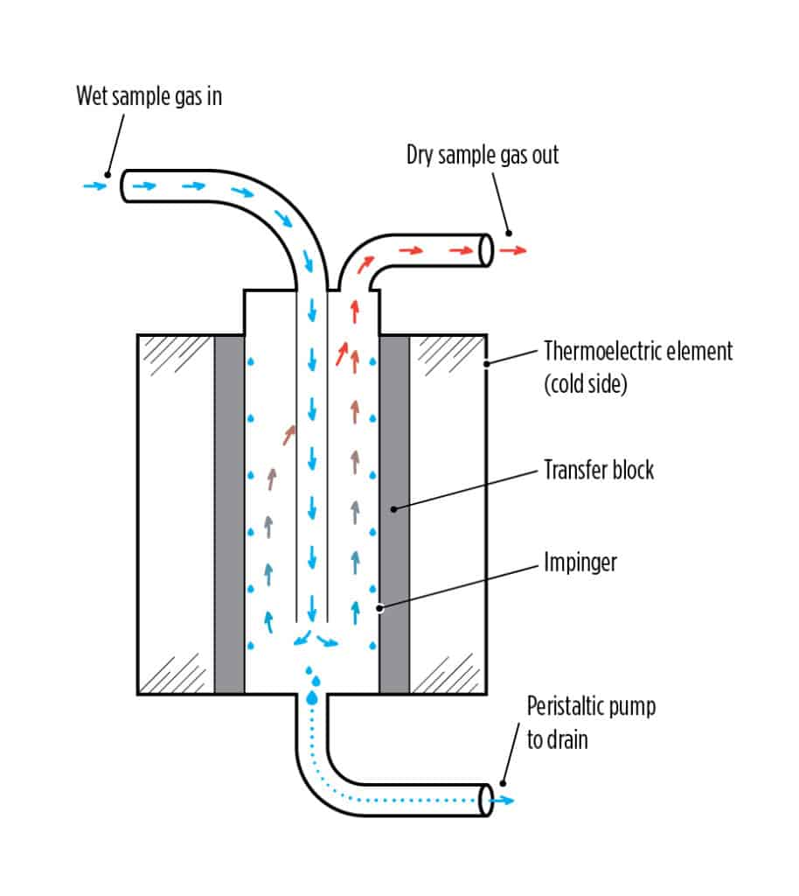
Changing Conditions Along CEMS Pathway
Heated Line:
Holds temp above acid dew point
Pump
Analyzer
Exit sample gas dew point = 4°C
Conditioning:
Thermo Electric Cooler condenses water and drains it from system

Slide 9
Areas of Concern Along CEMS Pathway
Higher than expected moisture levels may overwhelm impingers – moisture breakthrough
Unscheduled Maintenance
Inaccurate Analysis
Changing Ambient conditions, Cold spots or zonal dropout
Unscheduled Maintenance
Pump
Analyzer
Water carryover: Acid formation Corrosion
Loss of analytes
Not all condensed water may be trapped and drained

Slide 10
Changing Conditions Along Process Pathway
Sample moisture volume may be dynamic
Drying solution may remove only liquid water from line
Dew point reduction may not reach below ambient
Water vapor removal may not be low enough based on changing temperatures along pathway
Not all processes are linear, drying may need to be added at multiple points
Potential solutions:
Increase gas temperature
Remove more water in vapor form

Slide 11
Moisture Management Solutions

Slide 12
Thermoeletric Cooler
Water Trap
Pros
Provide a consistent moisture content within specifications(+4 C dew point)
In CEMS applications, this is the industry standard for gas sample conditioning.
Pros
Cost effective
No moving parts and no power required
Cons
Moisture content levels limited to +4 °C dew point
Unexpected moisture increases can lead to moisture breakthrough
In presence of acidic gases (e.g. SOx, NOx, and HCL) , water carryover leads to acid formation
Highly water-soluble components in sample may be lost
Cons
Only removes liquid water
Water-soluble analytes may be lost
Manually drained water may increase maintenance

Slide 13
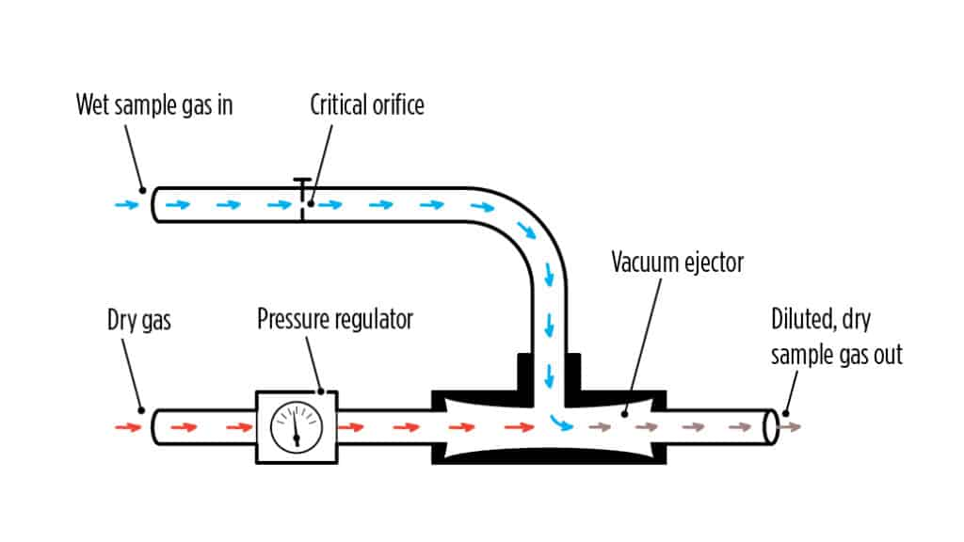
Desiccant Dryer
Gas Dilution
Pros
Cost effective
Achieves sub-ambient moisture levels
No moving parts and no power required
Pros
Low maintenance
Can achieve very low, sub-ambient, moisture levels
No moving parts
Cons
Desiccants non-selectively remove water and other analytes from the gas stream
Requires regular replacement
Performance of desiccant degrades over time leading to inconsistent output
Cons
Analytes becomes diluted in the gas sample, requiring increased analyzer sensitivity.
Critical stability of the dilution ratio can difficult to maintain due to variations in pressure and temperature
Requires access to a dry gas, such as instrument quality air

Slide 14
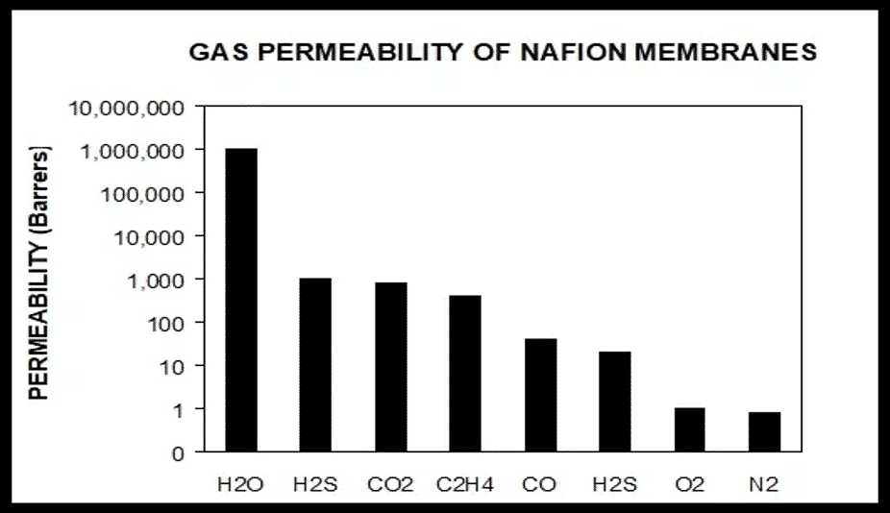
Nafion™ Technology
Copolymer of a Teflon™ backbone with periodic fluorocarbon sidechains which terminate in a sulfonic acid
Sulfonic acid groups participate in chemical reactions, therefore Nafion™ polymer:
Functions as an acid catalyst
Functions as an ion exchange resin with exposed to solutions
Readily absorbs water in vapor or liquid phase

Slide 15
Nafion™ Selectivity
Nafion permeation selectivity is based on chemical reactivity, not the size of the molecule – not traditional permeation
Only compounds that chemically associate with sulfonic acid permeate through Nafion
Bases associate with sulfonic acid and permeate through Nafion
Few bases are gases at typical operating temperatures, so very few compounds permeate
Retained by Nafion
Atmospheric Gases
Halogens
Hydrocarbons
Inorganic Acids
Other Organics
Oxides
Sulfur
Toxic Gases
Ar He H₂ N₂ O₂ O₃
Br₂ Cl₂ F₂ I₂
Simple forms (alkanes)
HCl HF HNO₃ H₂SO₄
Aromatics Esters Ethers
CO CO₂ SO_{X} NO_{X}
COS H₂S Mercaptans
COCl₂ HCN NOCl

Slide 16
Perma Pure Dryers
Reach dew points of -40°C
Flow rates up to 40 lpm
Temperatures up to 100°C
Tube in shell design: inner Nafion™ element with outer polymer or SS shell.
Removes water vapor based on partial pressure of water vapor differential
The sample gas flows through the tube, and the dry purge gas flows outside of the tube in the opposite direction
The flows are sealed off from each other
Available in a wide range of dryer lengths and tubing diameters
Sample Gas
Inlet
Sample Gas
Outlet
Purge Gas Outlet
Purge Gas Inlet
Notes:
Pressure max 6 barg for flow rates up to 4 lpm (MD) 2 barg for flow rates up to 40 lpm (pd)

Slide 17
Perma Pure Dryers
Pro
Achieves sub-ambient humidity levels (as low as –40 °C dew point) depending on configuration
Keeps analytes, including those that are water-soluble, in the gas sample
Provides a consistent humidity level of the output gas
No moving parts to wear out and no power required
Con
Requires access to a dry purge gas, such as instrument quality air, compressed air or use of another purge gas configuration
Damaged by Ammonia

Slide 18
Water Vapor Saturation Temperatures
°F | °C | % Water
212 | 100 | 100
158 | 70 | 30.7
149 | 65 | 25.2
141 | 61 | 20.0
131 | 55 | 15.5
114 | 46 | 10.0
95 | 35 | 5.55
68 | 20 | 3.31
50 | 10 | 1.21
41 | 4 | 0.80
32 | 0 | 0.61
12 | -10 | 0.26
0 | -18 | 0.12
Wet Scrubber
Natural Gas Combustion
TE Cooler output
Nafion Dryers remove 80% of Water Vapor left by Cooler

Slide 19
Emissions Monitoring
PP Dryer
Pump
Analyzer
Polisher for removal of water carryover to pump / analyzer
Protection from fluctuating moisture levels
Dew points down to -40°C
Prevents acid formation
Reduces unscheduled maintenance

Slide 20
Considerations In Moisture Removal
Is the actual dew point of the gas known at all points in process?
Can the environment along the pathway be controlled?
Does any part of the process affect the moisture content of the gas?
Unexpected increase in moisture content from source
Addition of other gases including ambient air
Do current drying solutions remove enough water
Liquid
Vapor

Slide 21
New Products

Slide 22
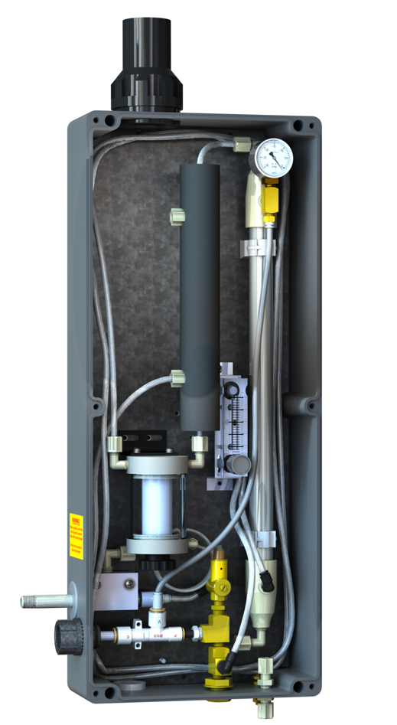
Hybrid Sample Gas Cooler

Slide 23
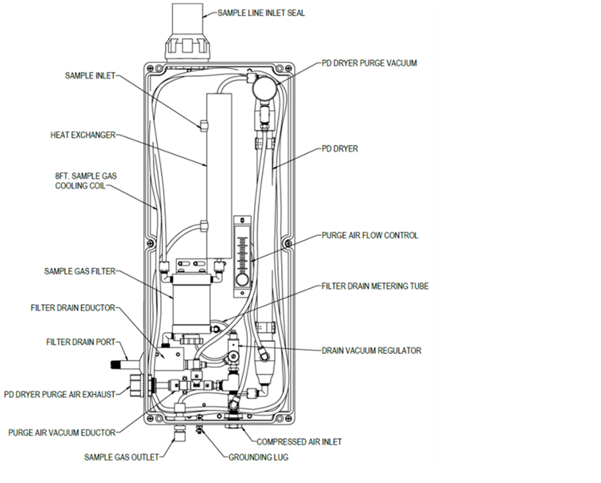
Hybrid Sample Gas Cooler

Slide 25
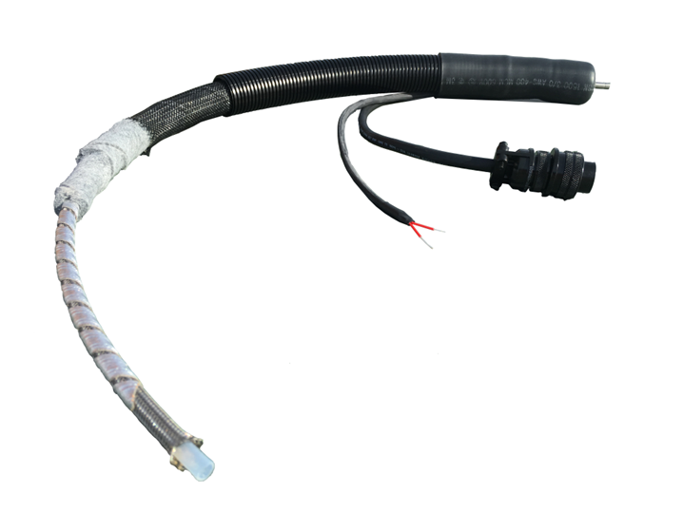
Heated Lines
Where are they used?
Transport the sample gas from the sample source to the gas conditioning system or analyzer
Moisture can distort the analytical measurement and damage the equipment
Ensure the temperature of the sample gas stays above the dew point to prevent condensation from occurring in the samples

Slide 26
Anatomy

Slide 27
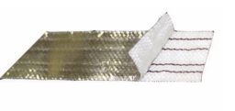
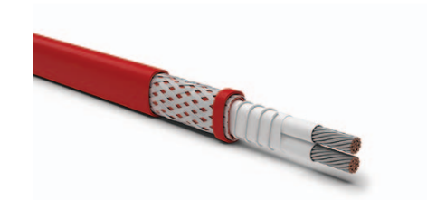
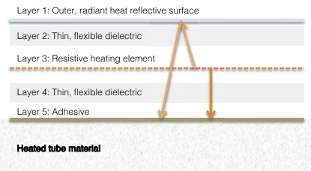
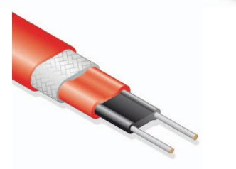
Anatomy of Different Heated Lines
Electrical Resistance Heat Tape
Constant Power Density (CPD)
Bus Wires
Alternating bus contacts at fixed intervals
Produces constant foot to foot power output
Heating wires
Insulation
Self-Regulating (SR)
Bus contacts surrounded by a conductive self-regulating heating matrix
Adjusts output heat in respect to increase and decreases in sample temperature
Insulation
Thermal Energy is transferred to the tube through both conductive and radiant modes of heat. Radiant energy emitted away from the tube is reflected back on to the tube.
Conductive Core Self-Regulating Heating Matrix
Bus Wires

Slide 28
Anatomy of Consistent Heating
Electrical Resistance Heat Tape
Heat Tape is precisely wound around the sample tube to provide consistent sample temperature along the entire circumference and length of the line
Flexible even when energized
Frequent movement does not damage the heating element
Ideal for rugged applications

Slide 29
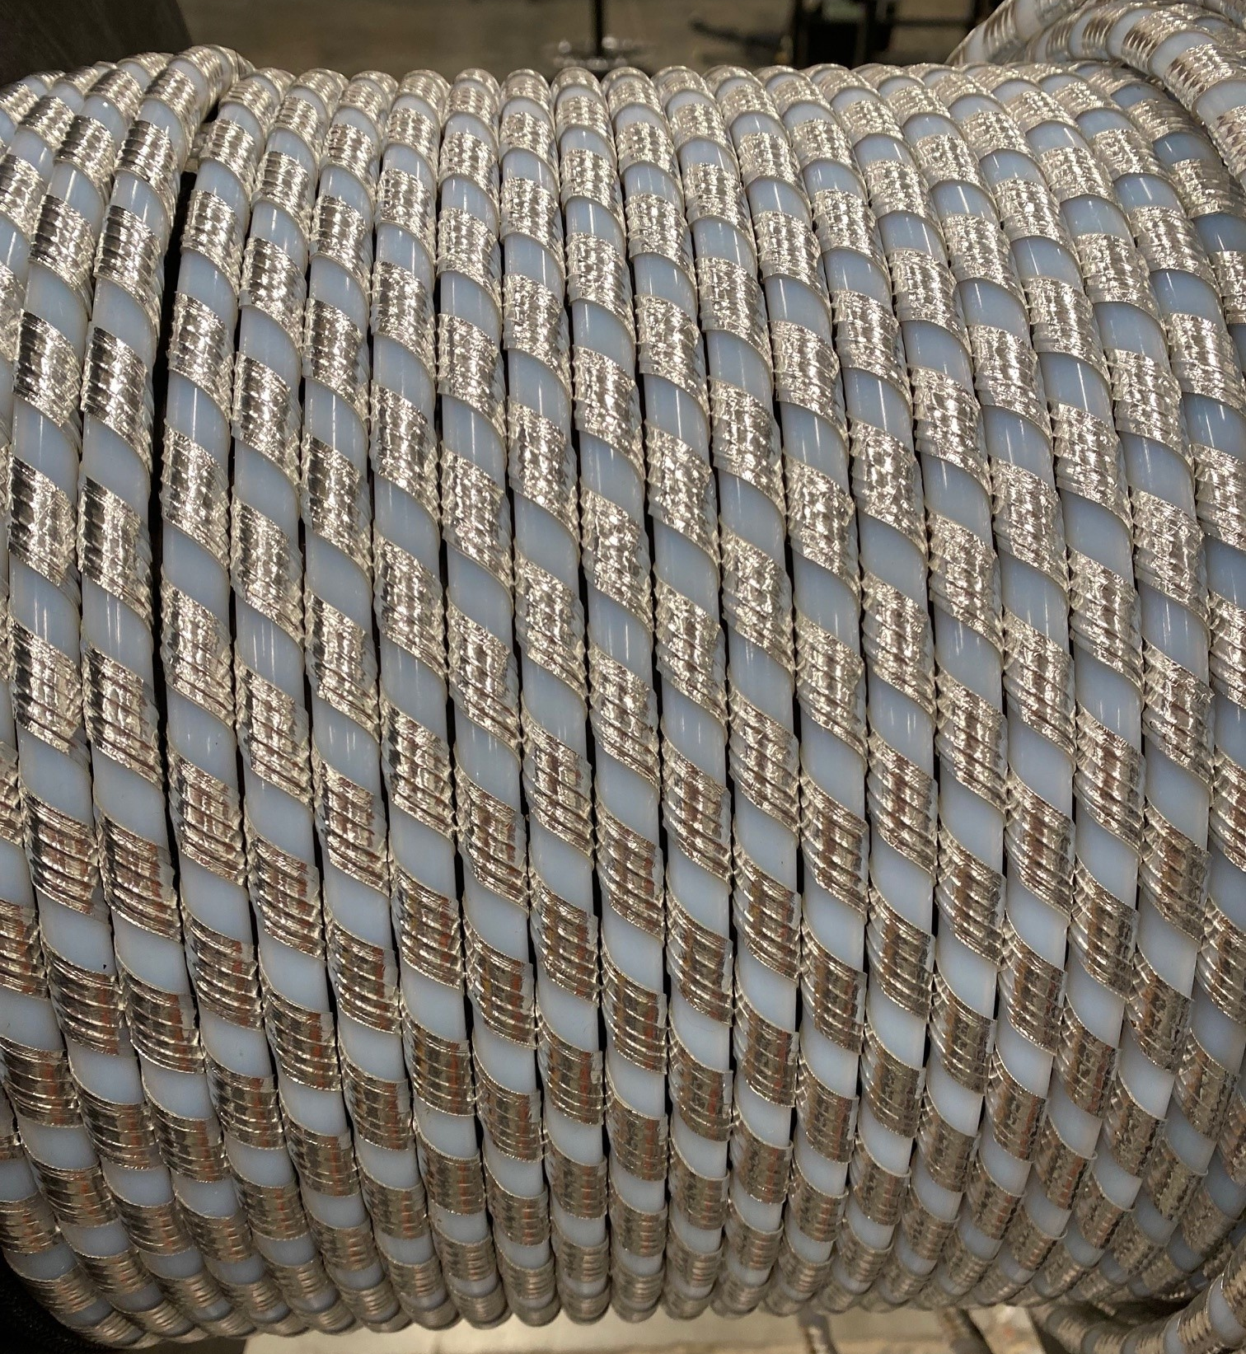
Clayborn Electrical Resistive Heat Tape
Heating Element
Electrical resistance heating tape
Highly efficient architecture
Rapid heat-up time
Precise wrapping for consistent heating
Customizable to achieve specific temperature / length / input voltage combinations
AC or DC operation
12v, 24v, 120v, 208v, 240, 277v, and 480v input
3-phase operation

Slide 30
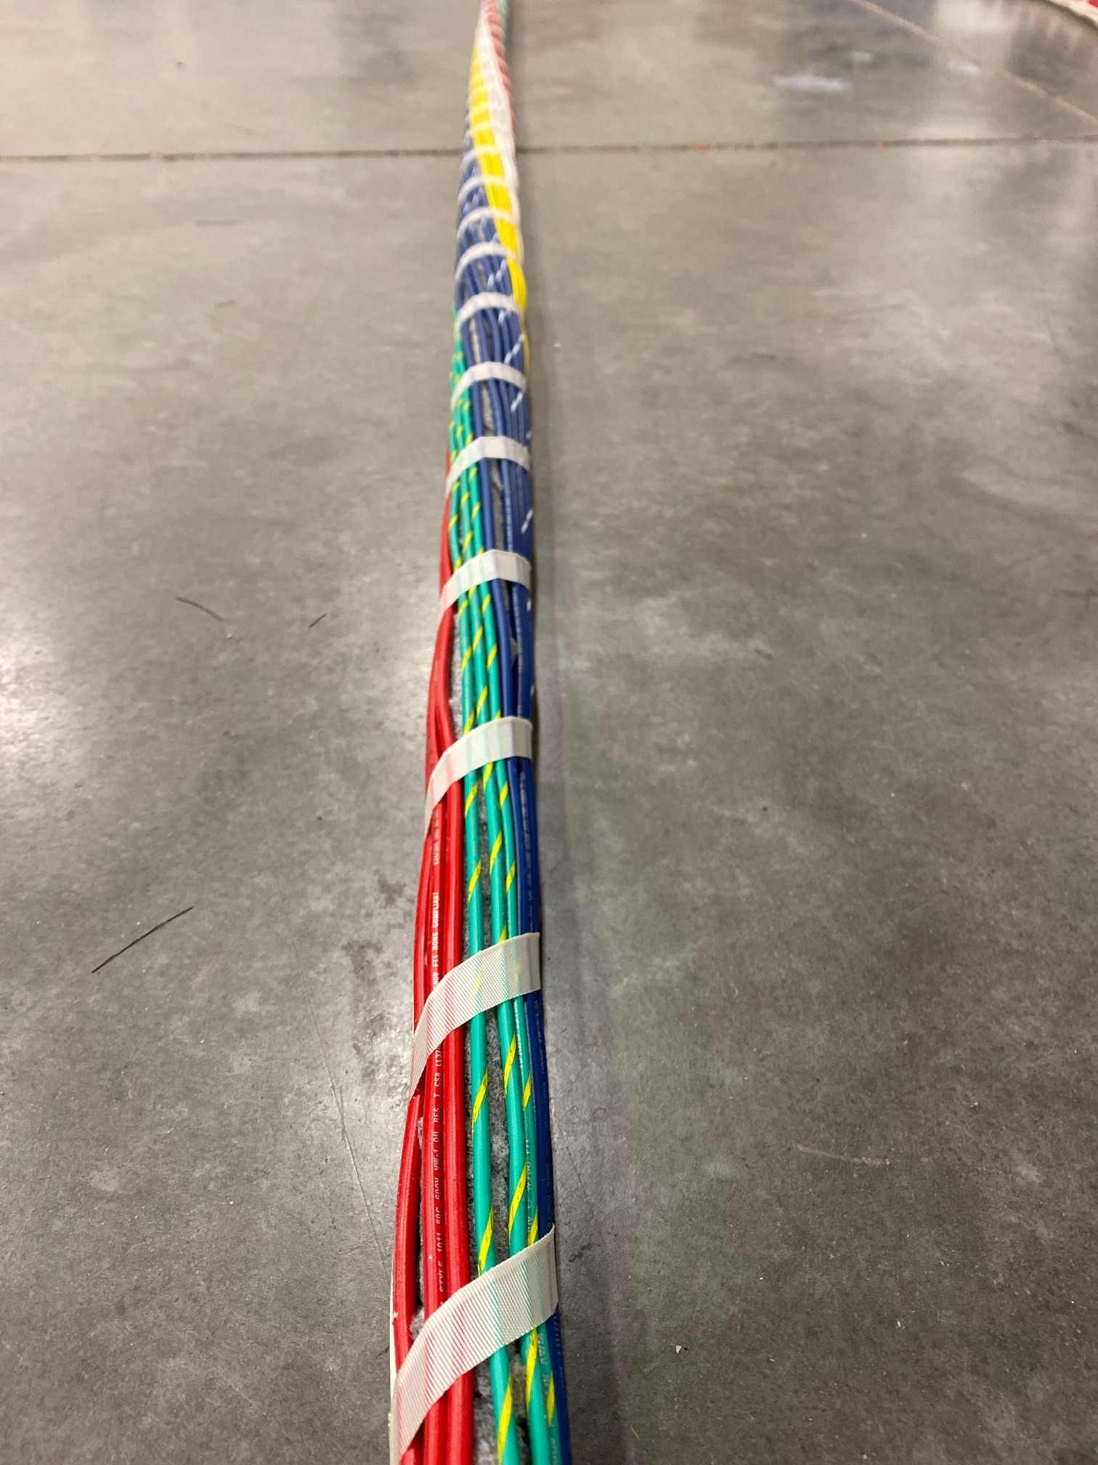
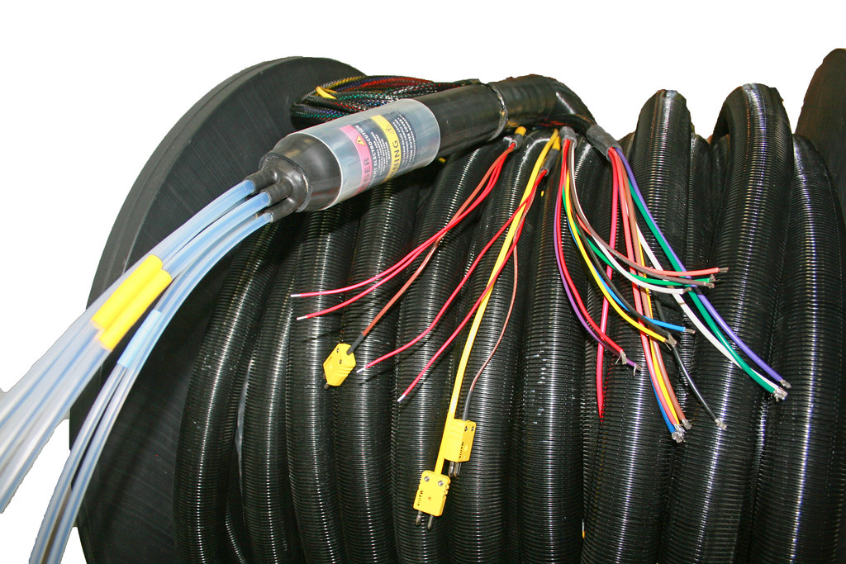
Customizable Designs
Up to 6 Heated Sample Lines
Up to 6 Unheated Sample Lines
24 pass through wires
Sample Line Materials:
Teflon
Various Grades
Smooth bore of convoluted
Stainless Steel
Welded or Seamless
Electropolished
Large ID convoluted
Polyethylene
Nylon
Insulation Materials::
Standard Nomex
High performance Aerogel
Closed/Open cell foam

Slide 31
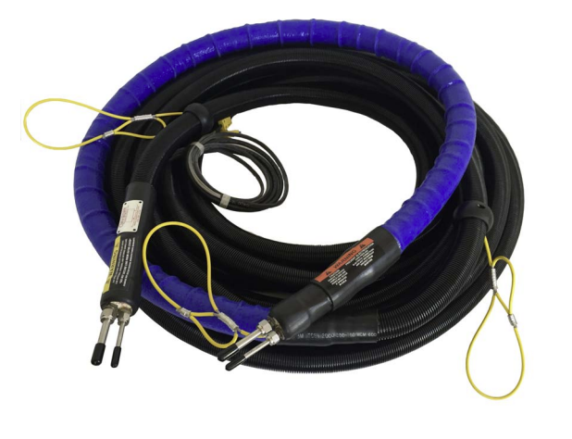
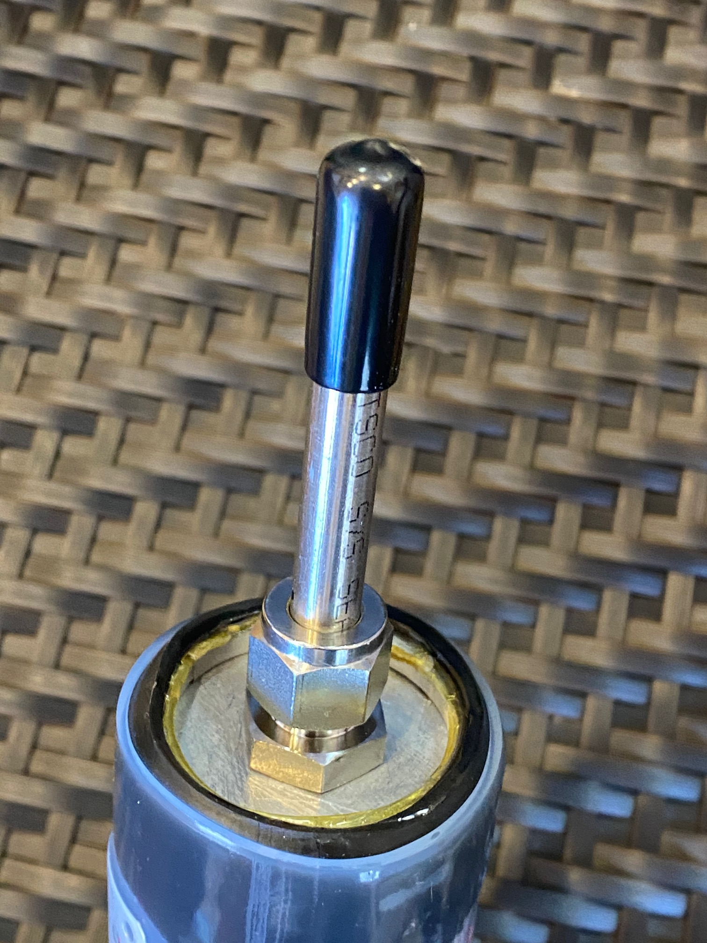
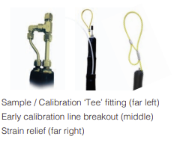
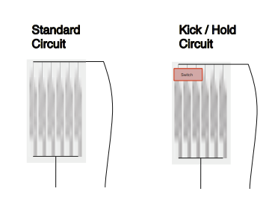
Customizable Design
Cover Options
Tuffguard
Nylon Braid
Silicone
Heat Shrink
Innovative Design
Integrated strain relief loops at customizable locations
Finished ends standard from factory
Armored Ends
Embedded Thermostats
Thermocouples
On/OFF indicator lights
“Run Wild” Temperature of sample line will fluctuate with ambient
Color Coding
Labeling

Slide 32
For More Information: www.PermaPure.com Laura Geenen LGeenen@PermaPure.com 848-224-3790
www.ClaybornLab.com Tim Edge Tim@ClaybornLab.com 239-826-1170
Thank you

