Slide 1
This material is protected by copyright law. The marks, Air Hygiene International, Inc. (AHI) and Air Hygiene University (AHU), along with their respective logos, are protected by trademark law. The material and the marks are the exclusive property of Air Hygiene International. All rights reserved.
CiSCO CEMS
USER GROUP
Keys to a
Successful RATA
© 2012, 2013 Air Hygiene International, Inc.
Paul Little, QSTI (I-IV)
Director of Customer Service
(918) 289-6378
plittle@airhygiene.com
Air Hygiene International, Inc.
1600 W Tacoma Street
Broken Arrow, Oklahoma
(918) 307-8865
Notes:
Introduce yourself

Slide 2

1
Objectives
Share a Written Standard
Present Air Hygiene’s approach to Relative Accuracy Test Audits (RATAs)
Discuss Services and Options (that could be advantageous)
Notes:
Setup the Continuous Improvement Structure

Slide 3
2
Checklist
Pre-mob
Setup
Test Day
Post Test / Before Demobilization
Report Review
Notes:
Setup the Continuous Improvement Structure

Slide 4
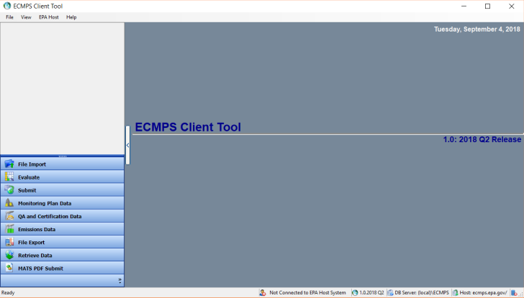
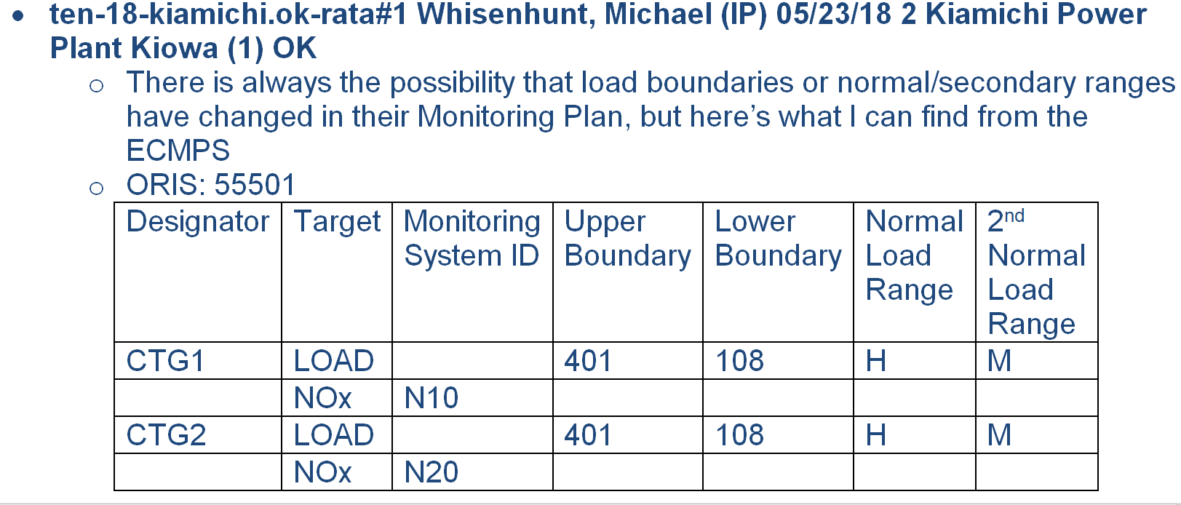
3
Before we Mobilize
Protocol
Unit specific info

Slide 5
4
What does “Normal” mean?
Notes:
But do you know where this comes from?

Slide 6
5
Setup
Time Synchronization
CEMS makes, models, serial numbers
How long is it going to take?
Are we going to pass?
Notes:
Encyclopedia Set

Slide 7
6
What if we don’t agree?
Work systematically
Work from least to most evasive
  Stack inspection
    Is the CEMS probe there?
    Is the RM probe off-gassing?
  Sample lines
    Are all lines heating
    To what temperature(s)
  Leak checks
Notes:
Encyclopedia Set

Slide 8
7
What if we don’t agree?
(continued)
  Re-calibrations
    Try system mode for RM?
  What’s the parameter
    NOx
      How does the NO compare
      Now does the NO₂ compare
      Run a CEMS NO₂ conv. check
  Re-calibrations with shared gases
  Tap into each others sample lines
Notes:
Encyclopedia Set

Slide 9
8
Test Day
CEMS Calibration
How long is it going to take?
Are we going to pass?
  Stratification test can confirm
Everything included in a post-test
review is something you’ll wish you
would have asked pre-test
Notes:
Encyclopedia Set

Slide 10
9
Questions to Ask
Load
  Stable / Normal / Sec. Normal
Primary fuel combusted?
Correct point or points [Strat]
NO₂ Conv efficiency ≥90%
Did the RATA pass
Is there a BAF
Was the tester a QI / QSTI
Was the company an AETB
Notes:
Encyclopedia Set

Slide 11
10
Questions to Ask
(continued)
Did all systems (CEMS and RM)
pass calibrations
Did RM runs follow proper QA
Did RATA run times match
Were both CEMS and RM wet or dry
Did the RATA use nine runs
Was each RATA run 21 minutes
Notes:
Encyclopedia Set

Slide 12

11
Let ECMPS Do It

Slide 13
12
Let ECMPS Do It
(continued)

Slide 14
13
Let ECMPS Do It
(continued)

Slide 15
14
Let ECMPS Do It
(continued)

Slide 16
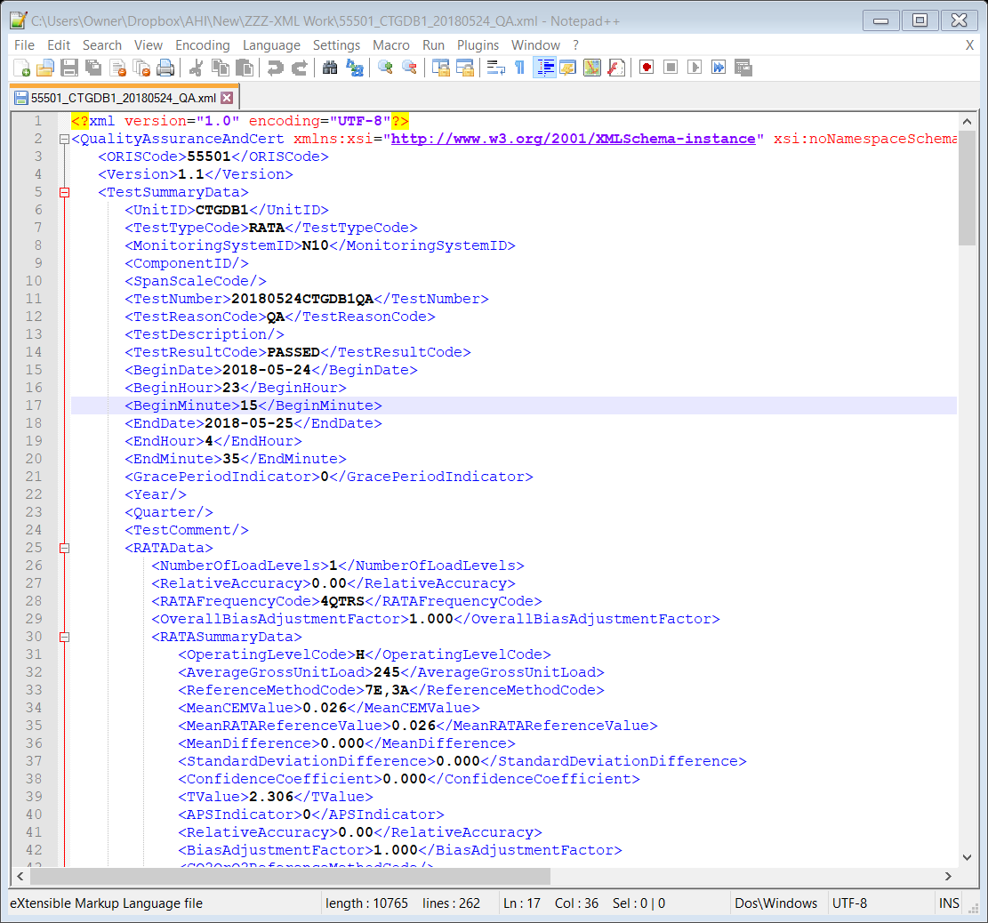
15
XML Code – Import and Eval

Slide 17
16
Outcomes
Four RATAs conducted at the wrong test loads
Several RATAs reported at wrong load (i.e. CT plus ½ steam turbine)
A few RATAs ±9 test runs

Slide 18
17
Advantages
Real time feedback
Captures our Field Manager’s “in the moment”
Corrective actions prior to demobilization

Slide 19
18
The Future… is now
Same type of “robotic” check system utilized for the report

Slide 20

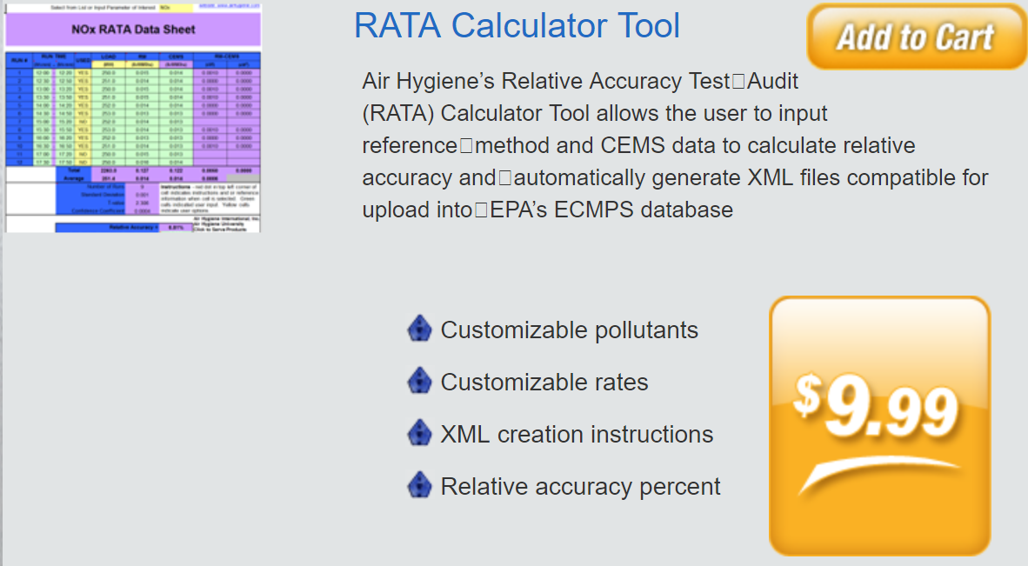
19
Services and Options
XML / JSON Code
RA Calculations
  https://www.airhygiene.com/store/Air-Hygiene-Carbon-Emissions-Calculator-Tools.aspx

Slide 21
20
Services and Options
Stack Testing
  Temporary CEMS
  Parts (i.e. Lines and Analyzers)
Cylinder Rental
Air Hygiene University

Slide 22
Questions, Comments, Concerns?

