Slide 1
CeDAR Configuration Options
Brian Rezek
Software Department Manager
September 13th, 2022

Slide 2
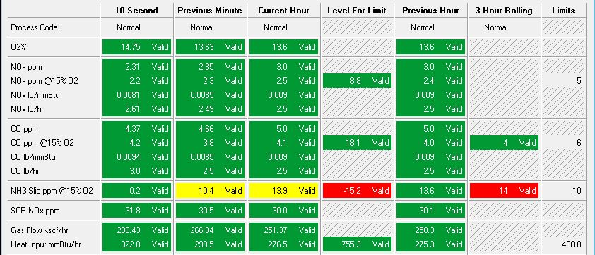
Color Coded Cells:
CeDAR screens can be customized for any color scheme.

Slide 3
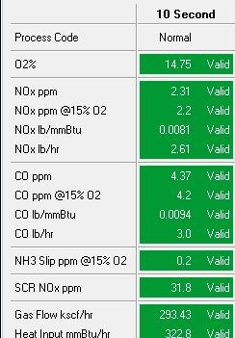
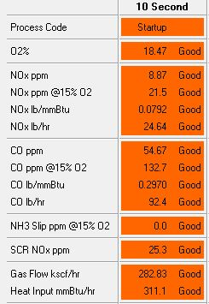
Color Coded Cells:
Colors can be defined based on monitor code or process code.

Slide 4
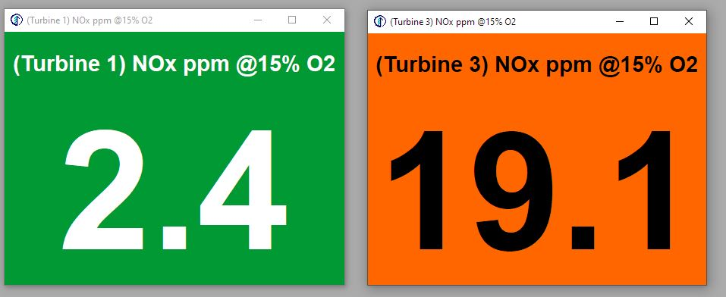
Color Coded Cells:
Custom colors extend to Giant Numbers.

Slide 5
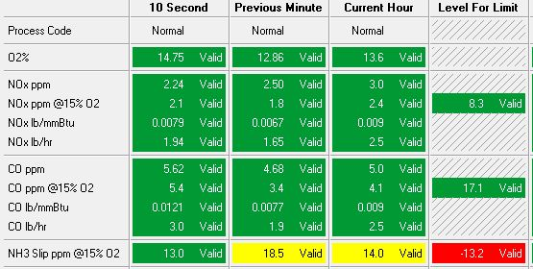
Level For Limit:
Provides operators a target value needed to meet the limit.
Operate below the level for limit to stay below the limit at the end of the hour/period.
Based on current and previous values in period.
Works for all short-term limit periods – Hourly, Multi-hour Rolling, Multi-hour Block, Daily, etc.

Slide 6
Save Several Reports with One Click:
We can set up CeDAR to run a predefined list of reports with a single click of a button.
Ideal for quarterly, semi-annual or annual reports where the same reports are submitted each reporting period.
Saves each report to an individual PDF file on the DAHS.
Saving all reports to a single PDF file is on our ‘to do’ list.
List of reports must be configured by CiSCO.
Ability for users to configure the report list is on our ‘to do’ list.

